Slide 1
VMware Cloud Foundation 9
Technical Overview
Notes:
Key Message:
Opening slide
Talk Track:
Welcome! My name is <name> and I work in the <name or organization> at Broadcom. Today, I want to discuss Cloud Foundation architecture, technical features and configuration detail.
Notes:
Resources:
To gain a greater understanding of VCF features, key concepts and how they are used please refer to the VCF Master Technical (Deep Div)e presentation.
VMware Cloud Foundation 9.0 Release Notes:
https://docs.vmware.com/en/VMware-Cloud-Foundation/index.html

Slide 2
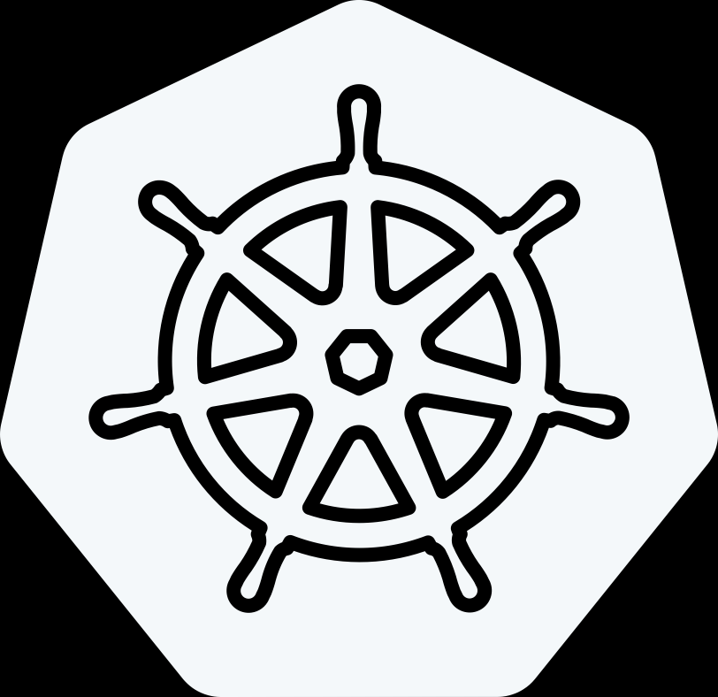
Delivering the Modern Private Cloud
VCF Advanced Services
Cyber Compliance
Advanced
Security
Load Balancing
Data Services
Application Services
Network
Observability
Business Operations
Identity Security
VMware Cloud Foundation 9
Modern Cloud Interface
Tenant Management, Content
Service Catalog, Orchestration, Applications
Private AI
Traditional VMs
K8s
Automation & Operations
Capacity, Configuration, Tenancy
SRE Ops, Fleet & Security Management,
Compute
Storage
Networking
On-Premises
Public Cloud
Sovereign Cloud
Edge
Telco
The information in this presentation is for informational purposes only and may not be incorporated
into any contract. There is no commitment or obligation to deliver any items presented herein.
Notes:
Talk Track:
Let's introduce VMware Cloud Foundation (VCF) 9 and the advanced services that are available with VCF.
VCF offers a flexible platform that can be deployed on-premises, in public clouds, within sovereign clouds, at the edge, or even in telco environments. This extensible approach allows VCF to support both traditional and modern application environments, enabling a wide range of deployment scenarios. One key feature of VCF is license portability, which we’ll explore in more detail later. This feature allows customers to take entitlements purchased on-premises and extend them across various environments, including public cloud providers, hyperscalers, sovereign clouds, edge locations, and telco environments.
When we talk about the personas that interact with VCF 9, we typically focus on two main groups: the cloud admins (formerly referred to as VI admins) and the consumers of the infrastructure. Cloud admins are responsible for deploying and managing the infrastructure from the ground up. This includes setting up the initial environment (Day 0), managing capacity, and ensuring proper configuration and tenancy for different consumers within the system.
Cloud admins are also focused on site reliability engineering, ensuring operational efficiencies are in place to scale effectively. They manage the underlying infrastructure for compute, storage, and networking, utilizing core VMware technologies like vSphere, vSAN, and NSX, as well as other networking technologies. All of this is integrated through an operational layer that provides fleet management, security, and automation, allowing the cloud admin to deliver a private cloud platform as a service. This infrastructure supports traditional VM-based applications, Kubernetes for container orchestration, and even AI and machine learning environments, including generative AI.
On the other side, consumers leverage the infrastructure-as-a-service (IaaS) components, which are abstracted for compute, storage, and networking. These services provide a framework for developers, platform teams, and DevOps teams to use IaaS and deploy multi-tenant environments. The platform manager oversees tenant management, ensuring everything is organized within a self-service catalog. This allows users to blueprint standardized models for deploying new applications, which include security, networking, storage, and compute requirements—such as GPU allocation. Once these models are configured, they can be easily deployed each time a consumer needs to build a new application cluster.
This setup also includes orchestration tools and application services necessary for a complete developer environment. Much of this is powered by the embedded Kubernetes runtime (VKE), the vSphere Kubernetes service, and associated services, which combine IaaS components with the other elements required to deliver a modern application environment. Together, cloud admins and consumers leverage VCF as a private cloud platform to deliver these services at scale.
Beyond the core VCF platform, VMware also offers a portfolio of advanced services to cover key use cases like private AI, disaster recovery, ransomware protection, advanced security (including cybersecurity measures for malware and ransomware), load balancing, application services, data services (such as database-as-a-service), network observability, business operations, and secure access. We’ll dive deeper into these advanced services in a future module.
Consumers can access these services through their preferred language, whether it's APIs, CLIs, or infrastructure-as-code, providing a flexible and scalable platform that meets a variety of needs.

Slide 3
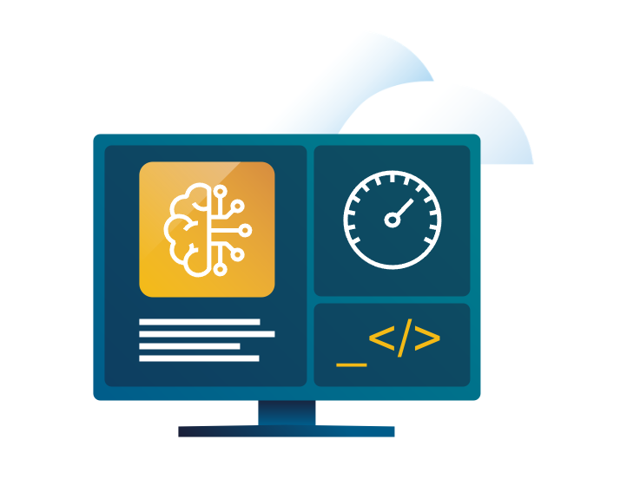
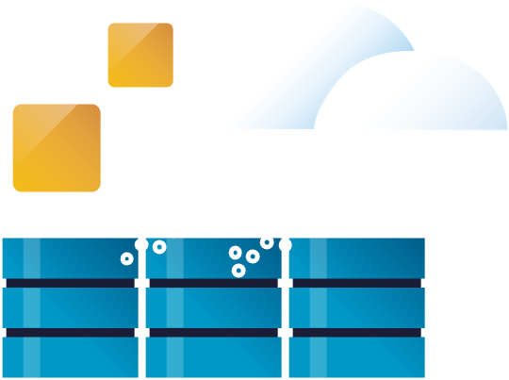








9 Common Use Cases for Private Cloud
Infrastructure Modernization
Application Modernization
Security Modernization
Build and deploy private cloud infrastructure on-premises
Enable self-service infrastructure and cloud services for app teams.
Strengthen compliance and harden infrastructure
Optimize infrastructure and operations
Build, run and manage Kubernetes and other modern workloads
Bolster lateral security and intrusions prevention/ detection
Extend data center to the Edge, public and sovereign clouds
Build, run and manage Private AI apps
Accelerate recovery from ransomware and other disasters
Notes:
Now that we’ve covered what VMware Cloud Foundation delivers, let’s look at how customers are putting it to work.
These nine use cases reflect real-world priorities we’re seeing across industries — and they map directly to the three pillars we’ve been discussing.
Under Modern Infrastructure, customers are building private cloud platforms to replace aging three-tier infrastructure — modernizing their core data centers with automated provisioning and full-stack lifecycle management.
Others are extending their private cloud out to edge locations, like retail stores and manufacturing facilities, where they need cloud services close to users and devices.
And many are delivering Infrastructure as a Service internally — providing dev teams or business units with on-demand access to compute, storage, and network resources without manual IT bottlenecks.
Under the Unified Cloud Experience pillar, organizations are accelerating application modernization by running Kubernetes clusters alongside VMs
We’re also seeing customers enabling Private AI — deploying NVIDIA GPUs on VCF to support AI model training and inferencing, all within their secure private cloud environment.
And they’re using DevOps principles like infrastructure as code to drive faster innovation across development and operations teams.
And finally, when it comes to a Secure and Resilient Platform, VCF helps organizations deliver ransomware protection by leveraging automated backup and recovery solutions integrated into the stack.
They’re deploying disaster recovery as a service between sites using VMware tools like VMware Live Recovery which is an advanced service for VCF.
And they’re ensuring continuous compliance for industries like finance and healthcare by embedding security policies at the infrastructure level.
These examples highlight how VCF helps organizations build modern infrastructure, create a seamless cloud experience across environments, and strengthen their security and resilience at every layer.

Slide 4
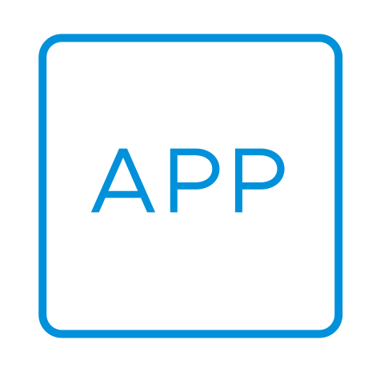
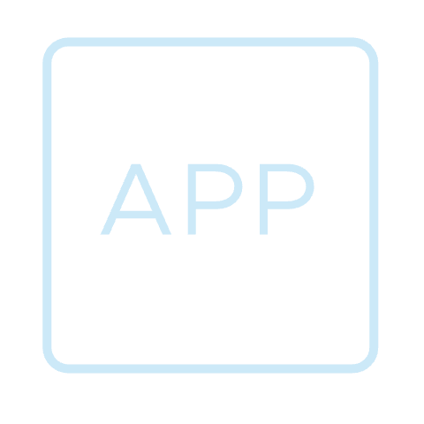
Deliver a Unified
Cloud
Experience
Secure
and Protect your Private Cloud
Modernize
Infrastructure
Architecture & Topologies
Deployment & Scale
Compute, Storage & Networking
Private Cloud Operations
Deliver Self-service IaaS
Migrating to VCF
Infrastructure for Kubernetes
Private AI
Operations
Infrastructure
Resiliency
Security
Notes:
Key Message:
VMware Cloud Foundation Drives Modernization, Enhances Developer Productivity and delivers a highly Secure cloud platform.
Talk Track:
VMware Cloud Foundation Drives Modernization, Enhances Developer Productivity and delivers a highly Secure cloud platform.
As we dive into VCF, we will see how VCF 9 streamlines infrastructure management and reduce complexity. How it speeds up development cycles through infrastructure that is easy to consume and update. How it delivers a Secure Infrastructure that you can continuously count on. And how it delivers faster time to value, by bringing together key stakeholders using a modern private cloud.
Notes:
Resources:

Slide 5
Modernize Infrastructure VCF Automation
Notes:
Key Message:
Talk Track:
Notes:
Resources:

Slide 6
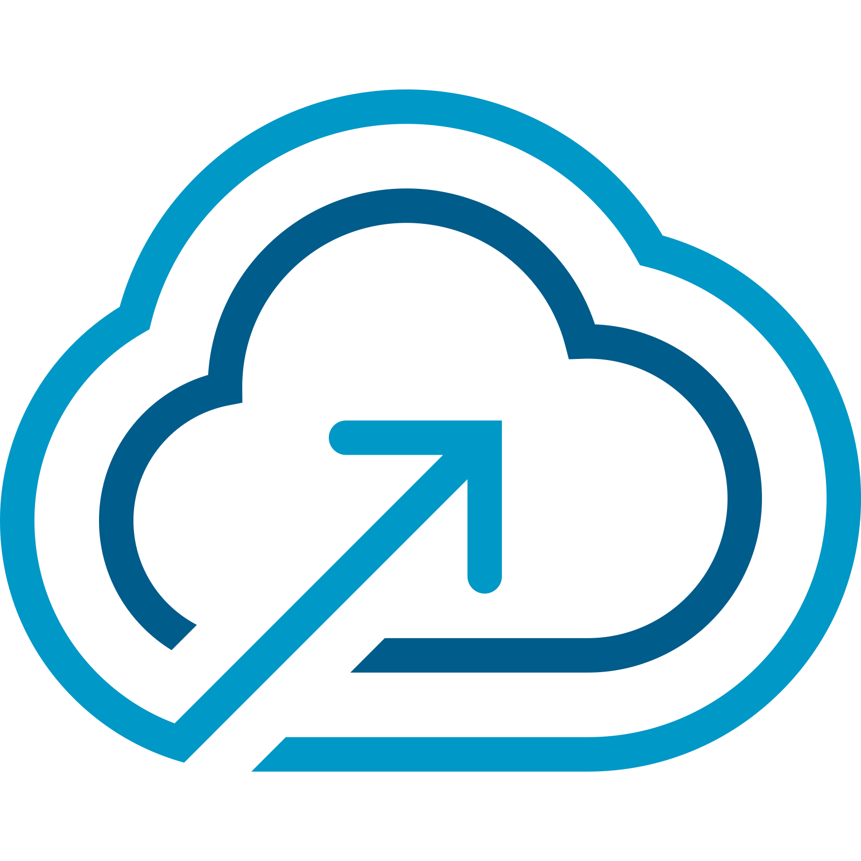
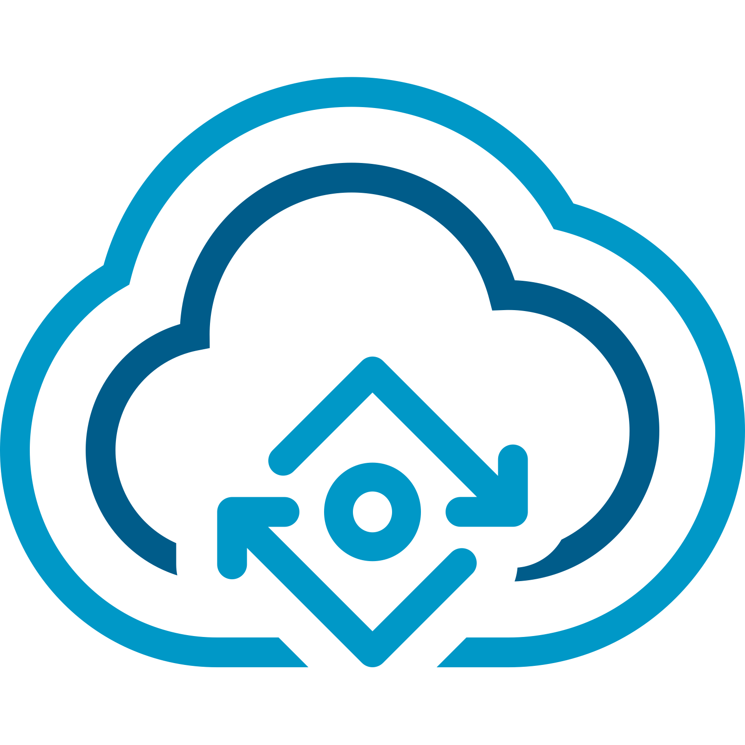
The VCF Automation Solution Overview
Deliver a Self-service Private Cloud for AI/K8s/VM-based applications
VMware Cloud Foundation
VCF Automation
Modern Developer Interface: AI/ML, K8s, Traditional VMs
Consumer
Developers, DevOps Engineers, Data Scientists, Low Tech Users
LOB Admin, Platform Engineers
Org Admin
Enterprise IT Admin
Modern Cloud Interface
MANAGE
OPERATE
Self-Service Catalog | Self-Service IaaS
Tenant Mgmt, Content
(UI / CLI / API)
Service Catalog, Orchestration, Apps
AI / ML
K8s
Traditional VMs
Governance & Policies
Infrastructure as Code
Private AI Automation
Supervisor Services
Tenant Management
Content Management
Orchestration & Extensibility
Workload Lifecycle Management
Core Infrastructure
Compute (vSphere)
Storage (vSAN)
Network (NSX)
Provider
Data Center | Edge | Service Provider | Public Cloud
Notes:
Key Message: VMware Cloud Foundation allows IT providers to deliver an application team-ready self-service private cloud for AI, Kubernetes and VM-based applications.
Talk Track: VCF Automation enables IT to deliver a self-service private cloud for AI, Kubernetes, and VM-based applications. ​
​
The solution makes it easier for IT teams (providers of IT services) to jump-start and scale a multi-tenant cloud with new public cloud-like IaaS Services (in addition to a curated self-service catalog) to help bring applications to market faster, while maintaining control with governance and policies. ​
​
VCF Automation helps VI Admins evolve into Cloud Admins (Enterprise IT Admin) that can offer self-service consumption of infrastructure resources “as a Service” to application teams (developers, DevOps Engineers, data scientists, and low-tech users).
​
With VCF Automation, IT Admins can support a Modern Cloud Interface with Supervisor Services, Infrastructure as Code, Private AI Automation, Workload Lifecycle Management, Orchestration & Extensibility, Governance & Policies, Tenant Management, and Content Management. ​
​
With these capabilities, the solution enables application teams to get the necessary infrastructure and make changes when needed. Application teams (the private cloud consumers) are no longer forced to worry about the intricacies of the underlying infrastructure and can focus on application development. ​
Notes:
Resources:

Slide 7
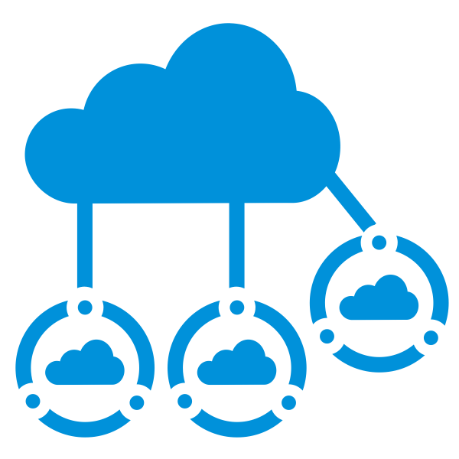


VCF Automation – Consume the Cloud
Integrated experience powered by Aria Automation and VMware Cloud Director
Tenant Management
Cloud Governance
End User Experience
Organize & Allocate Tenant Resources
(Tenant Management capabilities of vCD)
Tenant/LOB Admin Identity Management.
(Federated identity, groups, roles config)
Tenant Operations
(OOTB Ops, Capacity and Cost, Chargeback)
Governance Policies
(Quotas, leases, naming, showback)
Application Blueprints
(Traditional apps, Modern Apps and AI ML Apps)
Workflow Orchestration
(Event-based extensibility and workflow orchestration for IT/Business processes)
IaaS Surface for VCF
(OOTB Supervisor services - VM, K8s, Network, Storage, etc)
Application Catalog
(OOTB catalogs curating content from vCs, application catalogs, etc)
Extensible Services Ecosystem
(Object Storage, Data services, Backup, etc)
Notes:
Key Message:
VCF Automation empowers you to consume the cloud by offering an integrated experience
Talk Track:
If we want to talk about what’s NEW in VCF Automation in one snapshot slide, this is it. Three key strategic pillars comprise VCF Automation.
One is Tenant Management, which helps the IT Admins and the Service Providers take their VCF Infrastructure and allocate pieces of the infrastructure to tenants. These tenants could be either end customers in the case of a Service Provider or just internal lines of businesses in the case of Enterprise IT.
A good example would be Rackspace, a Service Provider with Coke and Pepsi as tenants.
The Service Provider can use the Tenant Management functionality to carve out the VCF infrastructure among one or many tenants.
Another example in the enterprise use case is Broadcom IT. They are using this capability for their 26 divisions to share one extensive VCF infrastructure, and they are using Tenant Management to allocate infrastructure to each division, like the VCF division, Tanzu division, ANS division, etc.
Beyond organizing and allocating resources in Tenant Management, we also consider tenant identity providers. Each tenant may have their own identity providers.
Last but not least, once the provider allocates these tenants, they want to be able to manage how the tenants are utilizing the environment, so they can perform chargeback functions. So with that first pillar of Tenant Management you may be saying Hey that sounds much like vCD, you know, you’re not wrong. We actually pulled in these capabilities from vCD into VCF Automation.
The middle pillar is Cloud Governance.
Cloud Governance is all about the tenants or the lines of business admins. Once they receive the allocated infrastructure, they can apply governance policies for their different application teams.
This could be quotas, leases, naming, and even resource level policies. Another part of governance among application team admins would be enforcing only specific configuration workloads being provisioned by their end users. They don’t want their end user to be provisioning anything they want.
The application team admins may wish to create a blueprint that mandates you must have these kinds of VMs configured in a specific manner, with a particular load balancer connected to it, and the software to install.
So, you can define a blueprint and then publish it as a catalog item for self-service consumption, which is a form of governance that our customers love today.
The third piece of governance is around workflow orchestration. If you think about any kind of provisioning VMs or Kubernetes clusters or anything in the cloud, it’s not a standalone thing. Every VM that is provisioned inevitably requires you to orchestrate many workflows. It could be registering the VM in a CMDB and integrating it with other software. We see this as a norm in every company where they have some workflow orchestration that is required as part of their provisioning process.
The last pillar, the most important from my perspective, is the End User Experience.
The End User we mentioned before gets a self-service catalog-based experience of curated blueprint content from the providers, the line of business admins, or the application team admins. In addition, these end users, for the first time, also get a public cloud-like IaaS surface for VCF. When they enter the VCF private cloud organization portal, they automatically start seeing IaaS services like virtual machine provisioning, Kubernetes provisioning, network, etc.
With this End User Experience, we offer a wide range of extensible services like object storage, data services, and backup, with the vSphere supervisor providing this capability. We take the power of the supervisor-based services and expose them to the end users through VCF Automation.
So, looking at these three pillars, you will know that it’s not just an incremental upgrade. This brings together the tenant management capabilities from vCD, the governance, projects, and blueprint capabilities from Aria Automation, along with the new supervisor-based capabilities in vSphere for the end users. All of this put together is the new VCF Automation.
Notes:
Tenant Management
Organizing and Allocating Tenant Resources
VMware Cloud Director provides embedded tenant management capabilities, enabling seamless resource allocation for tenants across your cloud environment.
Tenant / Line of Business Admin Identity Management
Ensure secure and flexible user management with:
Federated Identity: Single sign-on capabilities across the VCF components.
Groups: Simplified management of user groups for policy enforcement.
Custom Roles: Tailor access control to meet specific tenant or business requirements.
Tenant Operations
Streamline operational management through:
Out of the Box Operations: Access predefined operational workflows for smooth and quick consumption.
Capacity and Cost Management: Monitor and optimize cloud resource usage, ensuring efficient utilization and cost savings.
Chargeback: Implement chargeback mechanisms to accurately allocate costs back to business units or tenants.
Governance and Policies
Governance Policies
Enforce critical policies for:
Quotas, Leases, Naming, and Showback: Manage resource consumption, naming conventions, and visibility into usage for accountability.
Application Blueprints
Simplify application deployment and management with pre-defined templates for:
Traditional Apps, Modern Apps, and AI/ML Applications: Support for both legacy applications and modern, dynamic workloads.
Workflow Orchestration
Automate business and IT processes through:
Event-based Extensibility: Trigger workflows based on specific events, ensuring timely and responsive automation.
Workflow Orchestration for IT/Business Processes: Align IT processes with business needs, driving efficiency and flexibility.
Modern Cloud Interface
IaaS Surface for VCF
Access out-of-the-box IaaS services, which include:
VM, Kubernetes, Network, and Storage: Provide a full spectrum of cloud services to your tenants with a flexible, scalable infrastructure.
Application Catalog
Access a rich catalog of services with:
Pre-curated content from vCenters and application catalogs: Simplify the deployment and management of applications with ready-to-use templates and resources.
Extensible Services Ecosystem
Manage extensible services through a centralized interface:
Object Storage, Data Services, Backup, DR, etc.: Integrate and manage services like object storage, disaster recovery, and backup seamlessly within the cloud environment.
Resources:

Slide 8


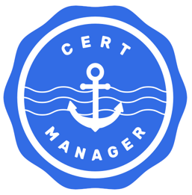
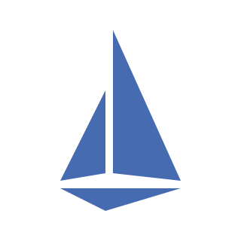
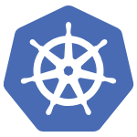
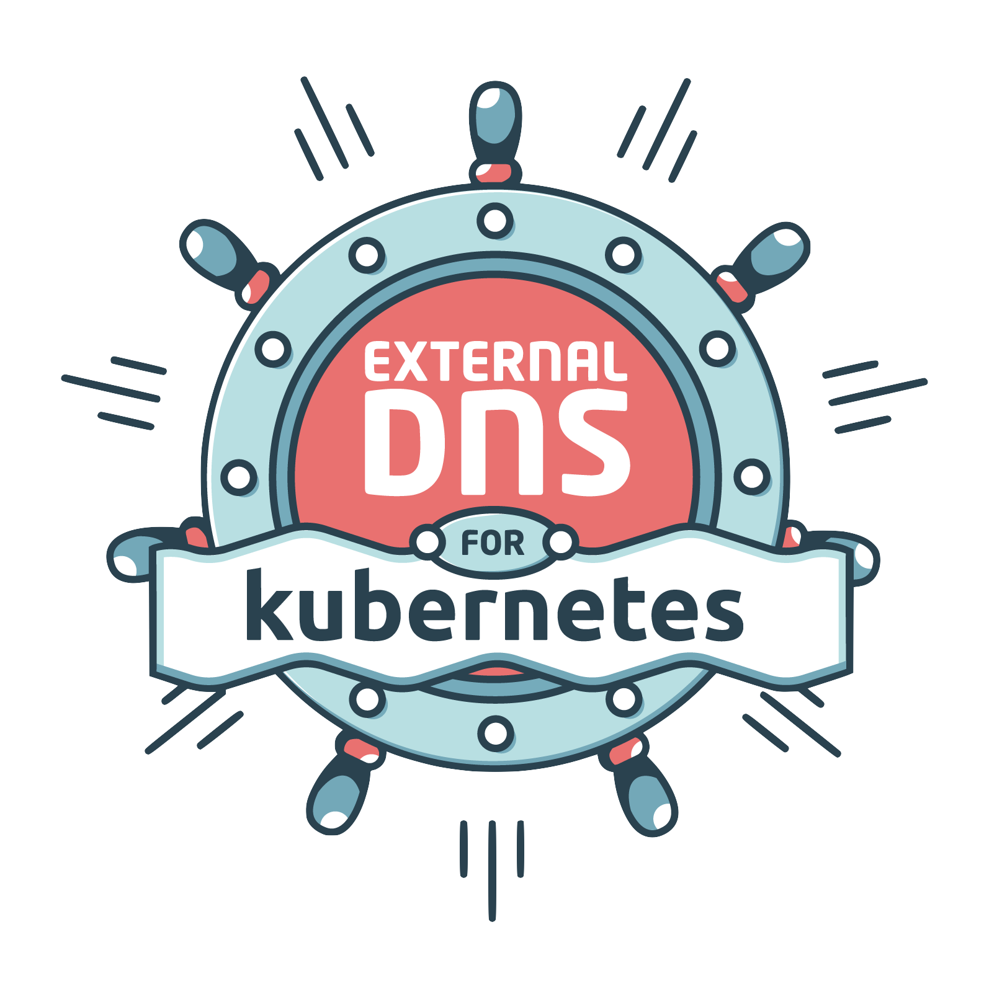

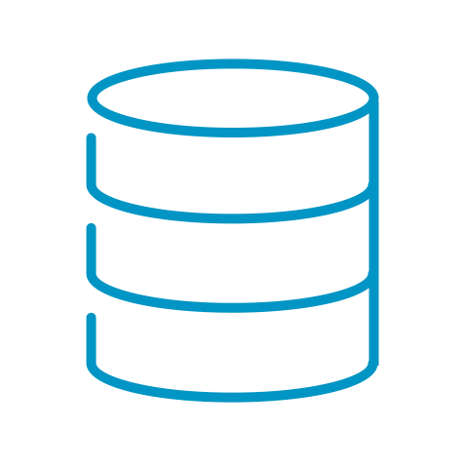

Supervisor Services
Deliver public cloud-like IaaS services in a private cloud, straight out-of-the-box. Expand with extensible services, increasing developer satisfaction.
VMware Cloud Foundation
Applications / Workloads
AI
K8s
VM
Supervisor Services
Core Services
Extensible Services
VM Service
vSphere Kubernetes Service (VKS)
VM Image
Image Registry
K8s Ingress Controller
Certificate Management
Service Mesh
New!
VM
Network Service
Volume Service
Velero
Backup Service
External DNS
DSM Consumption Operator
Secret Store
…
vSphere Supervisor
COMPUTE
STORAGE
NETWORKING
Note: Availability of certain features differ between Org for VM Apps and Org for All Apps experience
Notes:
Key Message:
In VCF 9.x, Supervisor Services are exposed across your environments and users have a choice to consume these services via UI, CLI, or Kubernetes-native APIs, they’ve got multiple ways to access and consume services — just like they would in a public cloud. Each service is namespace-scoped, meaning they operate within defined resource boundaries. The model provides a self-service experience, and dev teams can move fast as they can consume infrastructure without complexity and ticket wait times.
Talk Track:
In VCF 9.x, Supervisor Services are exposed across your environments, and users have a choice to consume these services via UI, CLI, or Kubernetes-native APIs; they’ve got multiple ways to access and consume services, just like they would in a public cloud. Each service is namespace-scoped, meaning it operates within defined resource boundaries. The model provides a self-service experience; dev teams can move fast as they can consume infrastructure without complexity and wait times for tickets.
Notes:
Let’s walk through some of the key Core services available out of the box:
VM Service - lets users declaratively define and deploy virtual machines using the VM Operator. The VM Service defines VM specs like CPU, memory, networks, power state, etc. The end user can also configure additional settings like Persistent Volume Claims, Load Balancers, Cloud-Init Scripts. This provides a comprehensive way to deploy a modern app onto a VM.
K8s Service - allows you to spin up Kubernetes clusters on demand. The vSphere Kubernetes Service can be used to deploy Kubernetes clusters quickly and easily, without the overhead of managing complex infrastructure manually. This service handles resource allocation, scalability, fault isolation, certificate management, and much more. One advantage to using this service is that you can deploy multiple versions of Kubernetes, making it perfect for testing new features or ensuring version compatibility for different applications.
Networking Service – is mapped to at least one VPC to a namespace, and within a network service, we can offer full self-service networking, starting from viewing already created VPCs. Networking Service can offer full self-service networking, starting from viewing already created VPCs, networks, and SGs, and then allowing the creation of new subnets and SGs. This is a different approach than creating a catalog item for this, and we are offering much more self-service here that we don’t plan to offer in the traditional approach in previous slide. In the future, we will also allow creation of new VPCs here and offer more complex connectivity for more advanced consumers.
Now let’s discuss some of the Extended Services:
Velero - used for data protection in Kubernetes environments. Velero is an open-source tool that helps you safely back up and restore cluster resources, perform disaster recovery, and even migrate workloads between clusters.
Cert Manager - managing SSL/TLS certificates in Kubernetes. Manage security of apps without having to manage certs manually.
Harbor - open-source, cloud-native container image registry that doesn’t just store your images. It also signs and scans them, adding layers of security and trust to your container supply chain
ExternalDNS - publishes DNS records automatically for your Kubernetes services and ingresses — using a declarative, Kubernetes-native approach.
Resources:

Slide 9
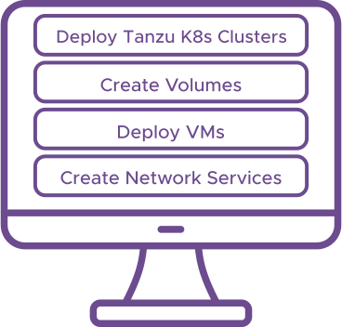
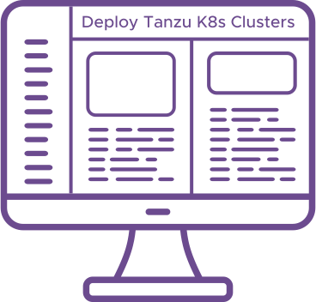

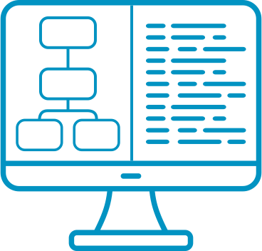
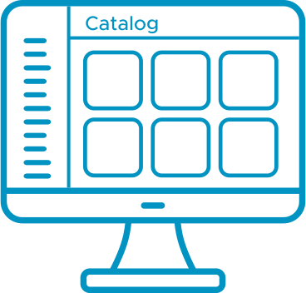
VCF Automation Governance & Consumption Models
VCF Automation isn’t just a simple VM provisioning tool
Enterprise/Service Provider Gov & Consumption Model
Traditional/Modern Workload Gov & Consumption Model
Self-Service IaaS/Catalog Gov & Consumption Model
Enterprise
Service Provider
Traditional + Modern Cloud Native Workloads
Self-Service IaaS experience (public cloud-like)
Traditional Workloads
VM
VM
VM
VM
VM
VM
K8s
AI
VM Service
Create K8s Cluster(s) on-demand
Project
A
Project
B
Project
C
Tenant
A
Tenant
B
Tenant
C
VKS Service
IaaS Namespace(s)
Network Service
Volume Service
Project(s)
Project(s)
Supervisor Services
VCF
VCF
Org(s)*
Org(s)
Hardware
Hardware
Self-Service IaaS with K8s CLI / UI / API
Cloud Zone(s)
Region(s)
No infrastructure isolation
Infrastructure is divided by identity access management
Infrastructure isolation
Isolated resource pool created in cluster (eg: GPU)
Can set allocations
No sharing of vCenter across Orgs
Costing (chargeback)
Dev/test/prod environments
vSphere Cluster(s)
Supervisor Cluster(s)
Self-Service Catalog experience
Org for VM Apps
Org for All Apps (default experience)
Curated Catalog(s) based on IaC blueprints
Notes:
Presenter Note: This slide contains animation
Key Message:
VCF Automation isn’t just a simple VM provisioning tool. It provides Governance and Consumption models for enterprise and service providers, traditional and modern workloads along with Self-service IaaS and Catalogs.
Talk Track:
By now, you probably understand that VCF Automation powers the private cloud self-service experience and isn’t just a simple VM provisioning tool. In VCF Automation, there are three new concepts that you need to be aware of.​
​
VCF Automation introduces three types of governance & consumption models.​
​
The Enterprise/Service Provider Governance & Consumption model is about whether a customer requires multi-tenancy or not.
Multi-tenancy is a cloud computing architecture where a single instance of software and/or infrastructure serves multiple “customers,” known as tenants (organizations), while keeping their data, processes, and infrastructure (compute, storage, network) isolated from one another. In other words, each organization has a dedicated environment. ​
Many Enterprise customers may not require such a type of multi-tenancy, and a single-tenant model is sufficient (sharing infrastructure resources, but segregating data/process via RBAC, etc.). Historically, “Aria Automation” supported this type of Enterprise customer. ​
Enterprises that operate like Service Providers (e.g., Broadcom) may require multi-tenancy that has infrastructure isolation requirements. Historically, “vCD” supported this type of Enterprise customer. VCF Automation can support both kinds of Enterprise customers.​
Most Enterprise customers may not care about multi-tenancy, so determine how much time you want to spend discussing this model, depending on your customer.​
<click>
2. The Traditional/Modern Workload Governance & Consumption model is about whether you need to support all types of apps (AI, K8s, VM-based) or only VM-based apps.​
It is very important to be aware that the default experience for VCF Automation supports all types of apps, delivered via the “Org for All Apps” experience. This is the new model that VMware would like all customers to adopt and consume. It is the strategic direction of the VCF product. The Supervisor technology in the underlying vSphere, enables this experience.​
However, some customers, including existing “Aria Automation” customers, may not be ready for this experience. In that case, as a “back pocket” solution, we also offer an “Org for VM Apps” experience that provides an Aria Automation 8.x experience for VM-only workloads. We highly encourage customers to adopt the new default experience; however, we understand that it may take time for some customers to adopt this newer model.​
Organization for All Apps is an organization used to run a wide variety of applications, including VMs, Kubernetes, data services, etc. This organization type can be used to create multiple tenants with secure infrastructure isolation, quotas, and chargeback.​
Organization for VM Apps is an organization used to support VM-based applications, powered by vSphere clusters. VMware Aria Automation customers can use this organization to continue to leverage the Aria Automation capabilities to provision VM-based applications via catalogs, apply policies, etc. ​
NOTE: We are NOT forcing existing customers to migrate from the old experience to the new experience. Customers are encouraged to explore the new experience and adopt/transition at their own pace.​ 3. Self-Service IaaS/Self-Service Catalog is about providing a flexible consumption/control model with a choice of consumption methods.​
Organizations (based on their internal policies and operational styles) can choose how much control they want to enforce. Organizations can balance the right amount of self-service consumption and apply controls at varying levels in various environments and stages of an application's lifecycle (conception, development, deployment, management, maintenance, and retirement).​
The Self-Service Catalog is a Provider-oriented approach, which is ideal for production environments, where the Provider (e.g., a Platform Engineer) offers a curated catalog with pre-approved standardized application blueprints. This is the approach that “Aria Automation” has always supported.​
In VCF 9.0, we are introducing Self-Service IaaS, which is a Consumer-oriented approach, which is ideal for dev/test environments, where Consumers can freely consume the OOTB IaaS services on demand, just like a public cloud (similar to EC2, EKS, EBS, etc. in AWS) for maximum productivity and efficiency. Through the K8s CLI/UI/API, users can create VMs, create VKS clusters, log into the VKS cluster, and apply applications. Application teams can also gain self-service networking based on governance established by the Enterprise IT Admin and Org Admins.​
​
Notes: Resources:

Slide 10
A view into the VCF Private Cloud Experience for each Persona
Self-service IaaS services and catalog
Day 2 operations on workloads and IaaS services
Workload operations visibility
End User, Developer, Platform Engineer
Enable new consumption experience with Projects, vSphere Namespaces and VPCs
Enforce policies – Quota, Leases, Approvals, IaaS policies
Manage content
LOB Admin or Org Admin
Organize infrastructure resources among tenants and LOBs
Setup networking
Manage tenant utilization and chargeback
Manage services ecosystem for tenants
Enterprise IT Admin or
Service Provider Admin
Notes:
Key Message:
A view into VCF Private Cloud Experience for each Persona. Talk Track:
Let’s walk through key personas for adoption and consumption of VCF from a VCF Automation context.
There are two types of users, the “Provider” (of IT services) and the “Consumer” (the consumers of the private cloud). (Note, personas are on a continuum, and the role is relative to who is receiving services vs providing services.)
The providers are concerned with organizing infrastructure resources among tenants and LOBs, setting up networking, managing tenant utilization and chargeback, and managing the services ecosystem for Tenants.
The Org Admin enables the new consumption experience with projects, vSphere namespaces, and VPCs. They create and enforce policies for quotas, leases, approvals, IaaS policies, and can also manage Content.
End users can consume Self-service IaaS services and the Catalog, perform day 2 operations on workloads and IaaS services, and gain visibility into Workload Operations.
Notes: Resources:

Slide 11
Modern Service Provider Experience
VCF Automation Tenant Management
Self-service consumption for developers and app owners
Secure multi-tenancy
Centralized governance for the IT infrastructure team
Unified platform for VMs and containers
Flexible resource allocation
Cloud-like networking
VPC
VPC
VPC
End User, Developer, Platform Engineer
vSphere Namespace
vSphere Namespace
vSphere Namespace
vSphere Namespace
LOB Admin or Org Admin
Project
Project
Project
Organization
Organization
Region
Region
Enterprise IT Admin
or Service Provider Admin
Supervisor
Supervisor
Supervisor
vSphere Zone
vSphere Zone
vSphere Zone
vSphere Zone
vSphere Zone
Cluster
Cluster
Cluster
Cluster
Cluster
vCenter
vCenter
Notes:
Presenter Note: This slide contains animation
Key Message:
VMware Cloud Foundation enables secure multi-tenancy by allowing isolated teams to share infrastructure through constructs such as vSphere Zones, Supervisors, Regions, Projects, and VPCs. Developers gain self-service access to VMs and containers, while IT controls security, policies, and resource governance.
Talk Track:
A modern private cloud provides multi-tenancy. Multi-tenancy is an architecture in which a software platform and infrastructure serve multiple isolated tenants, such as different teams, departments, or customers. Each tenant utilizes the underlying hardware and software resources but operates in a logically isolated environment with separate resources, data, configurations, and access controls. Let’s look at how VMware Cloud Foundation achieves this.
vSphere Zones correspond to vSphere clusters and delineate CPU and memory resources for workload placement. They do not include storage and networking. Zones are isolated to ensure that failures in one Zone do not affect others. Zones operate with the Supervisor to direct Kubernetes and VM scheduling, facilitating resilient workload distribution across fault domains.
<click 1>
The vSphere Supervisor integrates a Kubernetes control plane into vSphere, enabling clusters to run both VMs and containerized applications. Developers use Kubernetes tools, while IT manages resources through the vSphere interface. There is no need for a separate container platform. This unifies virtual machines and cloud-native applications on a single infrastructure.
<click 2>
At the VCF Automation level, regions are a logical grouping of compute, storage, VM Classes, and network resources, typically aligned with a geographic location. They facilitate resource allocation for tenants with different service levels. Each region comprises one or more Supervisors and supports performance, capacity, and feature-based segmentation.
<click 3>
Organizations are top-level constructs that isolate tenants and group users, policies, services, and resources within defined boundaries. They provide centralized access control, governance, and usage-based billing. Providers assign regional quotas to organizations, specifying the capacity and number of vSphere zones available to each.
<click 4>
With the underlying infrastructure, services, and controls in place, the organization admin creates projects. A Project is a logical construct that groups namespaces and their related VPCs (Virtual Private Clouds), users, and policies under a single administrative boundary. This simplifies management by allowing each project to have dedicated IP spaces, access controls, and security policies that do not interfere with other projects.
<click 5>
A VPC (Virtual Private Cloud) is an isolated virtual network environment that delivers cloud-like networking capabilities within your on-premises data center. It includes components configured by the organization admin, such as subnets, routers, and NAT, to enable easy self-service access to networking resources for tenants. Each VPC provides isolation, making it ideal for multi-tenancy, development environments, application owner segmentation, etc.
Within a VPC, one or more vSphere Namespaces provide the resources from a vSphere Supervisor cluster where Kubernetes workloads can operate. It serves as a container for applications, integrating the concept of Kubernetes namespaces with vSphere-specific features such as resource limits, access control, storage policies, and container network settings.
<click 6>
End users, such as developers and app owners, can access these resources in a self-service manner while organization admins and provider admins ensure security and governance. End Users can deploy virtual machines and modern applications without configuring or understanding the underlying infrastructure. This approach helps control costs and facilitates faster development cycles, enhancing speed to market.
Notes: Resources:

Slide 12
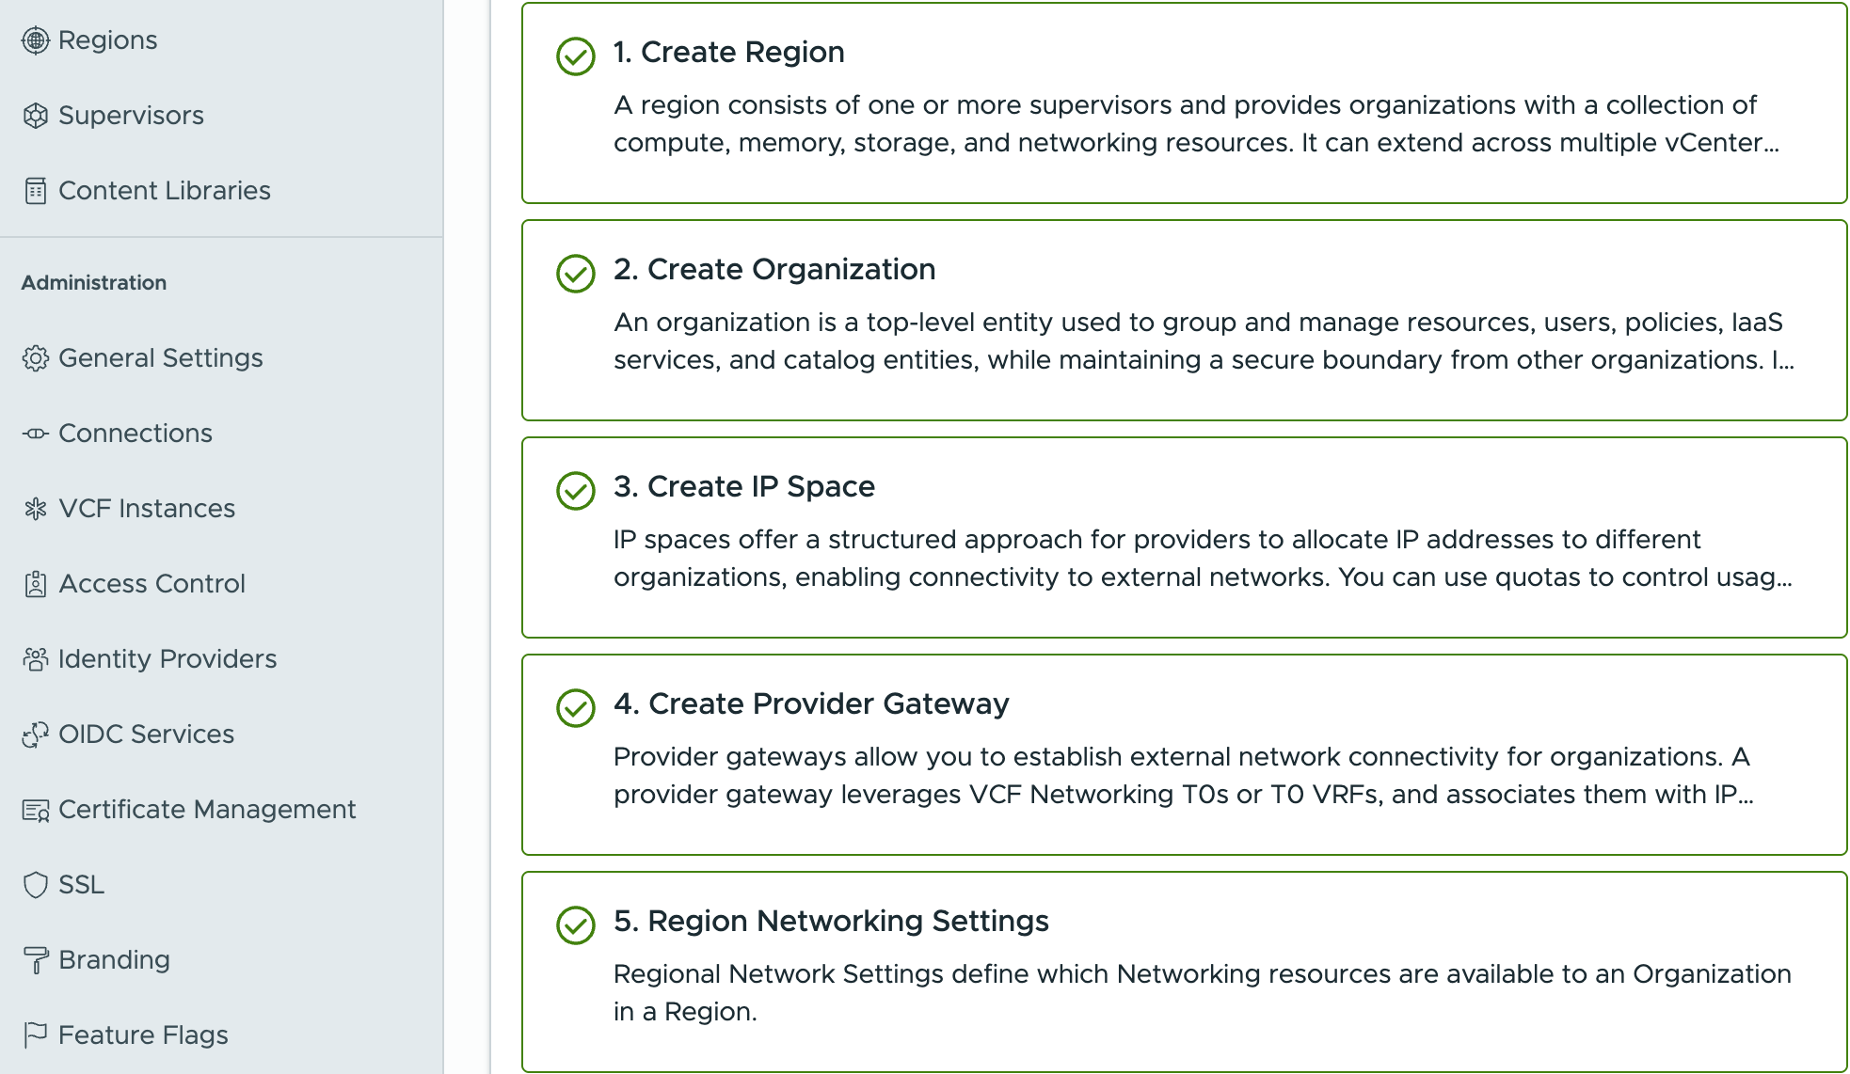
Built-in Guidance for Creating Your Modern Private Cloud
VCF Automation Tenant Management
…
Create regions and tenant organizations
Define IP Spaces for easy allocation of IP blocks to consumers
Create provider gateways to enable external connectivity
Assign provider gateways, edge clusters, and IP Spaces to organizations
Notes:
Key Message:
VMware Cloud Foundation provides built-in guidance for establishing a modern private cloud through a structured approach to scalable, secure multi-tenancy. By incorporating regions, organizations, provider gateways, IP spaces, and regional network settings, VCF enhances the delivery of isolated resources, external connectivity, and high-availability infrastructure.
Talk Track:
The first step involves creating a region. A region consists of one or more supervisors and provides organizations with a collection of compute, memory, storage, and networking resources. It can extend across multiple vCenter instances, provided the supervisors communicate with the same NSX instance, i.e., within the same network boundaries. A region typically aligns with a geographic entity such as “US-East.”
Next, we add an organization. An organization is a top-level entity that groups and manages resources, users, policies, IaaS services, and catalog entities while maintaining a secure boundary from other organizations. It provides centralized billing, access control, and a resource-sharing structure, facilitating collaboration and governance across teams, departments, business units, or entire companies.
IP spaces provide a structured method for providers to allocate IP addresses to various organizations, facilitating connectivity to external networks. Quotas may be utilized to manage usage. For internal communication, organizations can independently manage their own IP address blocks.
Provider gateways allow organizations to connect to external networks. A provider gateway utilizes NSX Tier 0 Gateways or T0 Virtual Routing and Forwarding (VRF) tables and links them with IP addresses from IP spaces that can be advertised through those gateways. A provider gateway may be assigned to one or more organizations.
Regional Network Settings determine the networking resources available to an organization in a specific region. These settings enable administrators to assign provider gateways, edge clusters, and IP spaces to organizations, facilitating external connectivity, routing, and IP address management. This configuration ensures that each organization can access the necessary infrastructure for north-south traffic, high availability, and tenant isolation.
Notes:
A VRF table in NSX offers logical separation of Layer 3 routing tables, allowing different tenants or services to operate with isolated routing policies without the need for separate physical routers or Tier 0 gateways. In other words, it enables tenant isolation, permitting the use of overlapping IP addresses across tenants. It helps avoid the need to deploy multiple T0 Gateways.
Resources:

Slide 13
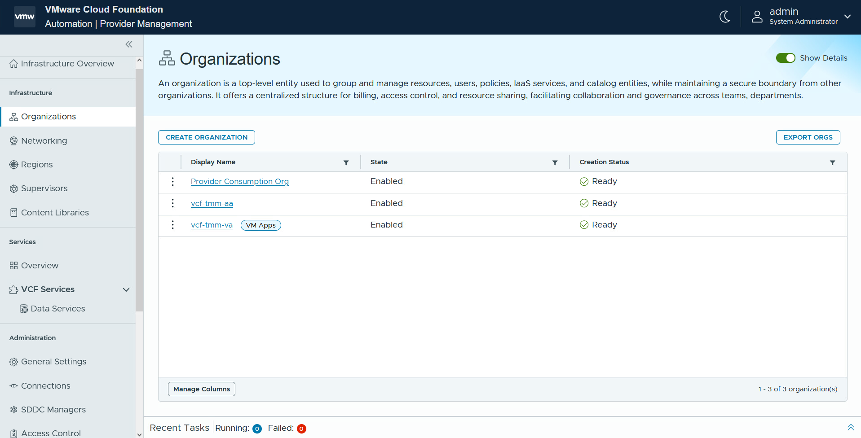
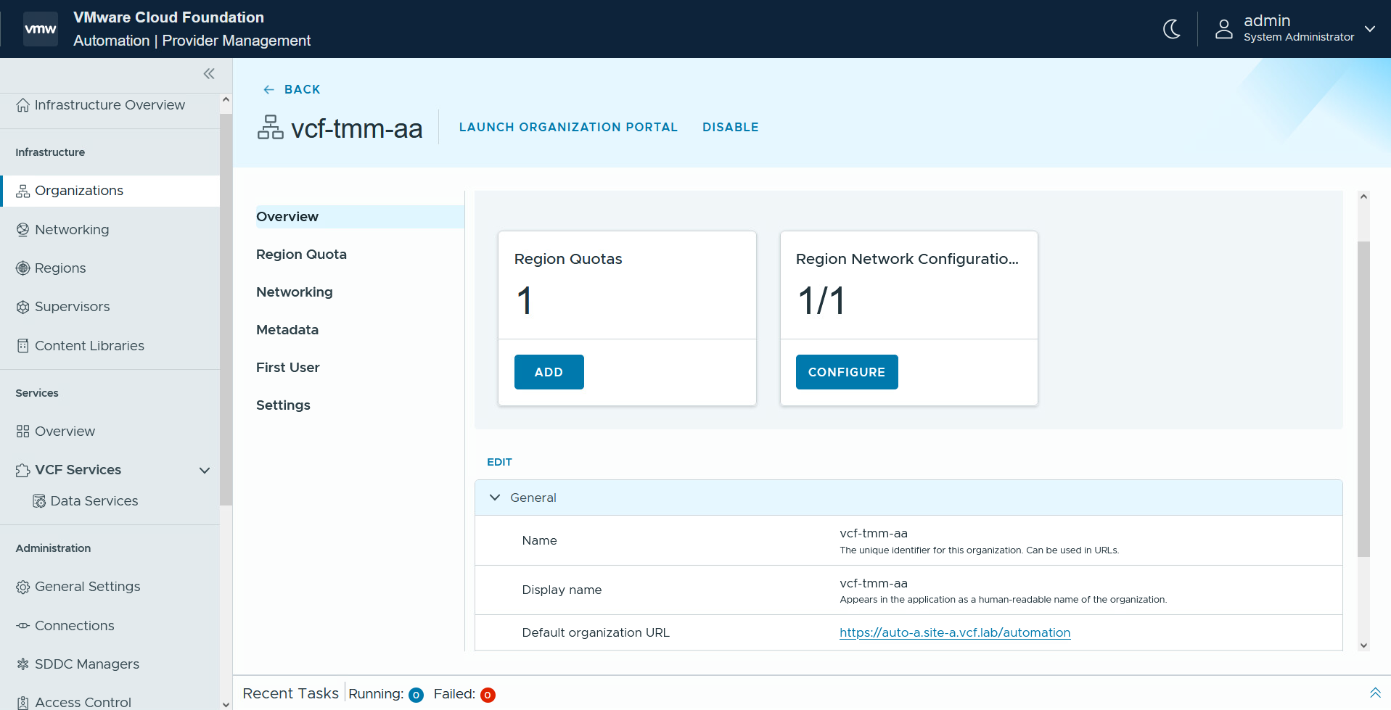
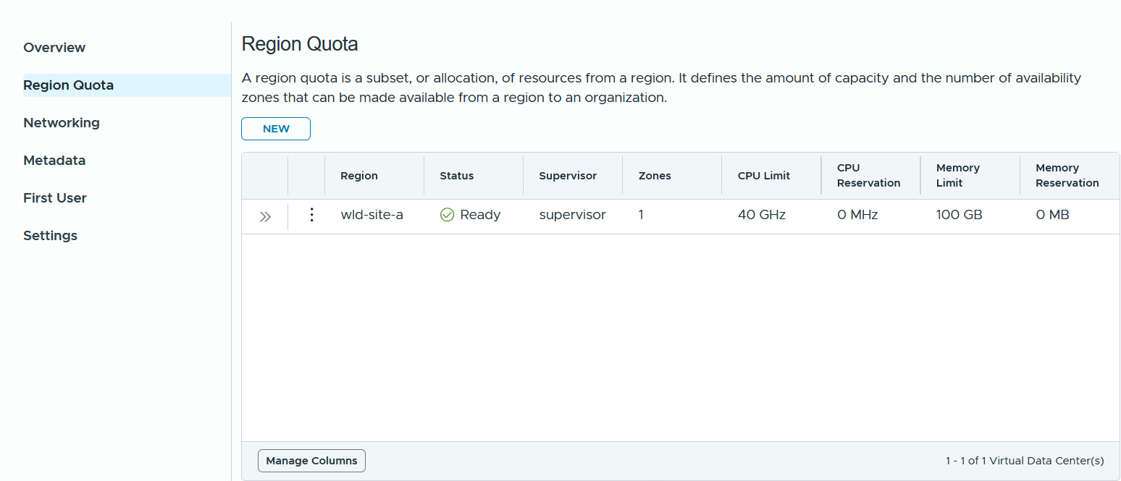
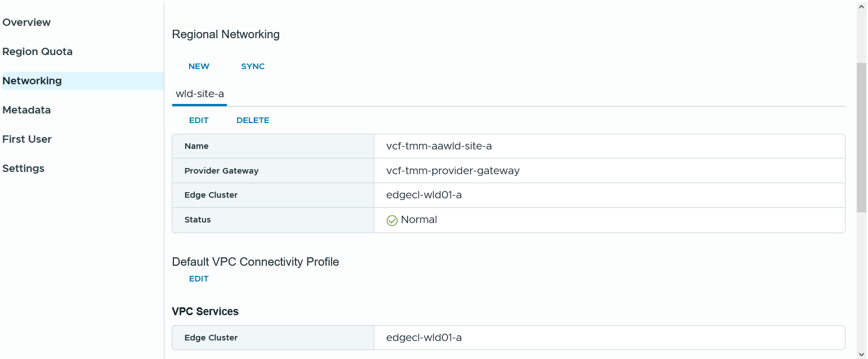
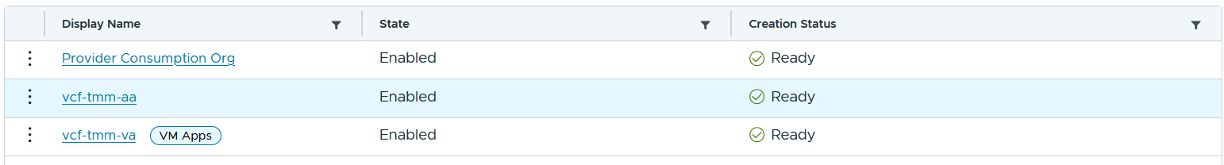
Streamline Organizational Resource Management and Operations
Build a secure and efficient Private Cloud
Highly available and fault tolerant.
Comprehensive network isolation.
Improved compliance and security.
Extensible services ecosystem.
Increased visibility and control:
Enables application teams to choose multiple vSphere zones for deploying applications.
Organizations have separate resources and use VPCs to isolate teams in those organizations.
Manage resources, set quotas, control permissions, offer managed services like encryption and backup.
Notes:
Key Message:
VCF Automation enables single or multi-tenant private clouds, allowing IT Admins to allocate resources to organizations, each managing users and resources specific to their group. The first step in building a private cloud is to break down a shared infrastructure into individual segments and allocate these segments to different organizations. This approach ensures that each organization feels isolated from the others while allowing for secure and efficient use of resources tailored to their specific needs.
Talk Track:
With VCF Automation, you can select multiple vSphere zones to deploy applications. This flexibility will enable teams to optimize resource utilization, enhance application performance, and ensure redundancy across different zones, ultimately improving the reliability and scalability of their deployments.
By ensuring organization isolation at the networking level and aligning with NSX tenancy constructs, we provide comprehensive network isolation throughout the stack while guaranteeing immediate internal and external connectivity upon the creation of the organization.
Improved compliance and security measures ensure consistent policy enforcement across LoBs, minimizing human error while adhering to organizational and regulatory standards. IT administrators can also provide organizations with a comprehensive Private Cloud experience supported by an extensible managed services ecosystem from VMware.
Enhanced cost visibility and control are achieved by providing deeper insights into the consumption of cloud infrastructure through chargeback and showback methods. This approach allows for more informed decision-making and proactive resource management. These controls effectively manage consumption, prevent over-provisioning, and help eliminate unnecessary costs.
<click 1>
<click 2>
A Supervisor can be deployed on three vSphere Zones to provide clusters with high availability and fault tolerance, which are essential for building highly reliable applications.
<click 3>
First, ensure that each organization is isolated from one another in terms of networking and computing resources. Next, establish network isolation for different application teams within each organization by using Virtual Private Clouds (VPCs). Finally, implement a transit gateway to facilitate communication between VPCs and to enable connectivity with external networks outside the organization.
Enterprise IT admins manage resources and set quota policies for each org. They control identity, permissions, and operations, and they organize content management across different LOBs. Additionally, IT admins can provide various managed services such as encryption, backup, and data management using services created by VMware and third-party software vendors (e.g., Veeam for backup services).
Additionally, if desired, custom branding can be created for each org console within VCF Automation, allowing for a distinct branding experience for each org.
Notes: For a short and sweet summary of Tenant Management, explained in an alternative way (spans across different themes):
Organization Management: Create, manage, and maintain organizational units to structure organizations effectively.
Resource Management and Allocation to Organizations: Allocate and manage cloud resources such as compute, storage, and network quotas across organizations.
Cost and Chargeback: Track resource consumption and generate cost insights, enabling chargeback or showback for individual orgs.
Access Control and Identity Management: Manage user roles, permissions, and authentication to ensure secure and tailored access for each org.
Content Management: Share content such as blueprints, images, and workflows from the provider to multiple organizations for seamless consumption.
Resources:

Slide 14
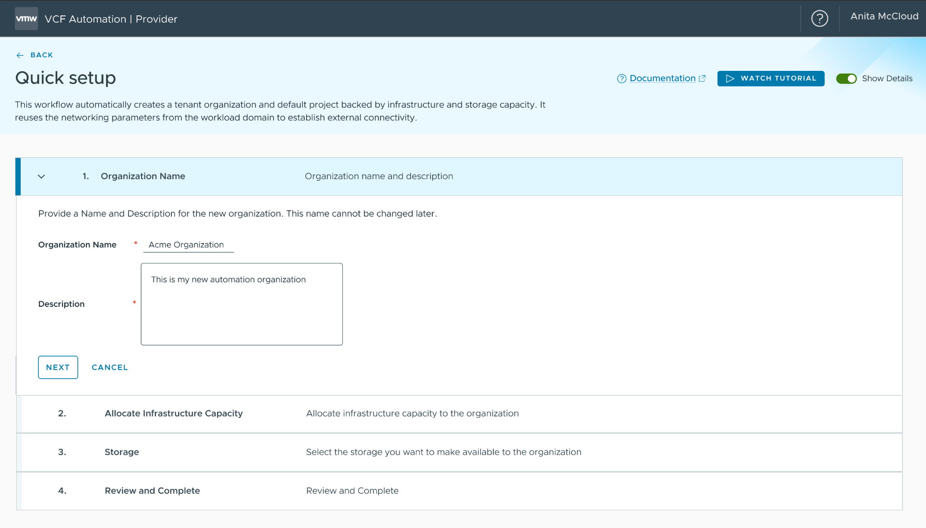
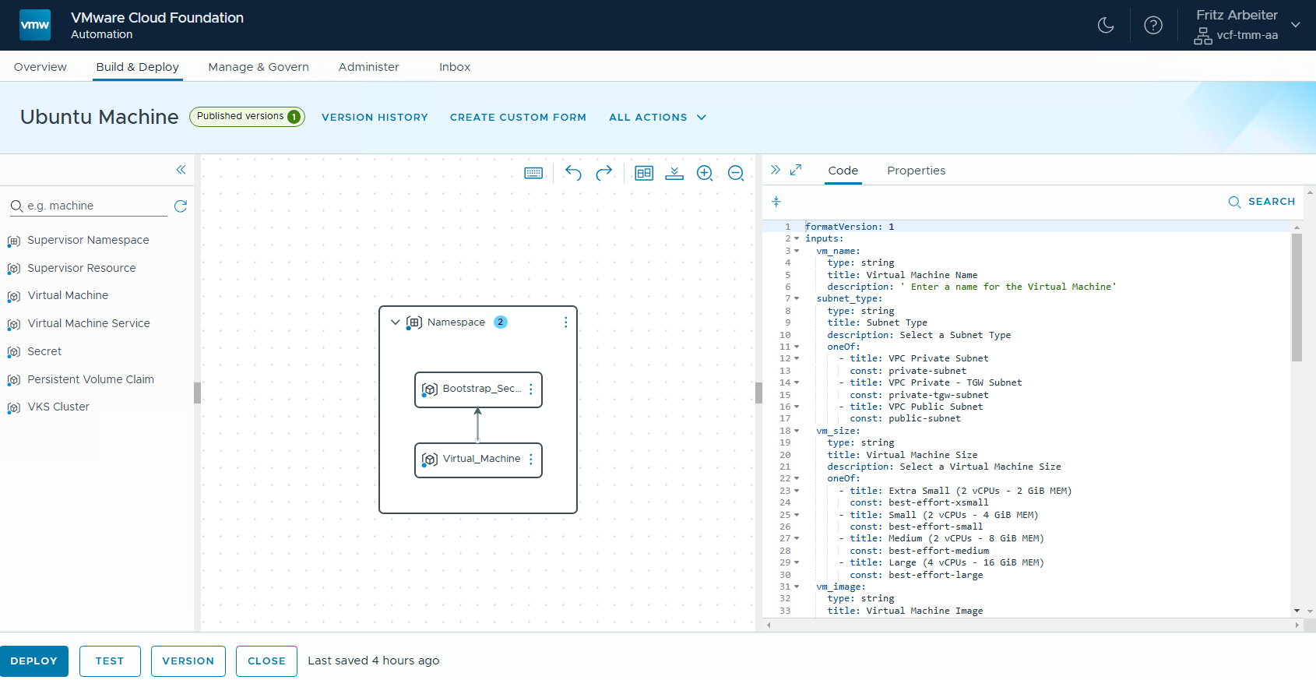
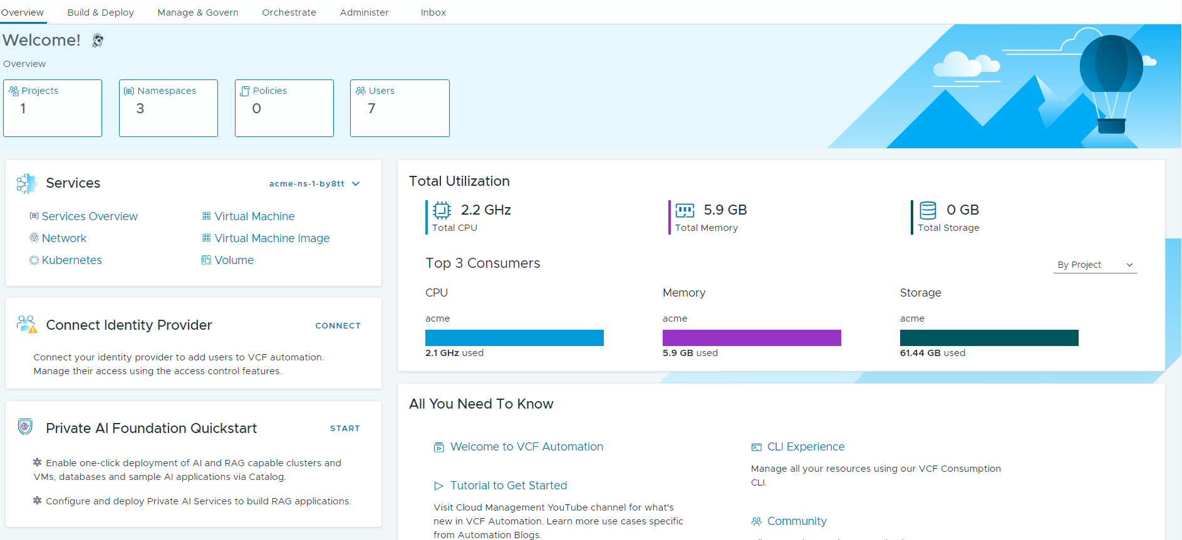
Streamlined processes for efficient Organization Management
Quick Setup and Guided Workflows to Configure Organizations
Simplify the adoption process for customers using VCF Automation 9, streamlining processes to save time, reduce errors, and boost productivity.
Enhance onboarding and support to create a better user experience.
Create organizations with network-isolated workloads and external connectivity through automated project and vSphere namespace creation.
Guided workflows assist users who opt out of the Quick Start.
Notes:
Key Message:
With guided workflows in the quick setup, a customer can easily adopt VCFA 9 for the first time.
Talk Track:
With the Quick Setup feature, we have streamlined the process for IT Admins, enabling them to establish organizations more efficiently.
Instead of thinking about every detail from the beginning, they can start with a basic setup, with VCF Automation guiding IT Admins through the initial setup tasks.
The automatic creation of projects and vSphere namespaces by default accelerates the process of provisioning workloads almost immediately.
Additionally, having a default Virtual Private Cloud (VPC) setup establishes a network isolation domain within the organization, laying the groundwork for future scalability when multiple network isolation domains are needed.
<click>
When opting out of the Quick Setup, no configurations are set up. However, the product provides get-started guided workflows to assist in completing the necessary steps, which enhances organization onboarding and support.
These guided workflows can help to streamline the learning process, making it easier for administrators to understand and effectively utilize the system, ultimately leading to better user satisfaction and engagement.
Notes:
Customer Benefits:
The Quick Setup feature streamlines the process for IT Admins, enabling them to establish organizations more efficiently. Instead of thinking about every detail from the beginning, they can start with a basic setup, with VCF Automation guiding IT Admins through the initial setup tasks. This allows them to gradually gain proficiency and take on manual configurations as they become more familiar with the system.
Note: There is a Quick Setup at the Org level and that is the Quick Setup Wizard for Private AI but this is use-case specific (not everyone will have access).
So, one main benefits of providing guided workflows for users who opt out of the Quick Start and have no configurations is that it enhances user onboarding and support. These guided workflows can help to streamline the learning process, making it easier for users to understand and effectively utilize the system, ultimately leading to better user satisfaction and engagement.
When opting out of the Quick Start, no configurations are set up. However, the product provides guided workflows to assist in configuring the necessary resources.
Key Attributes:
Enterprise IT administrators can quickly move from zero to a fully functional organization capable of creating network-isolated workloads with external connectivity. The automatic creation of projects and vSphere namespaces by default accelerates the process of provisioning workloads almost immediately. Additionally, having a default Virtual Private Cloud (VPC) setup establishes a network isolation domain within the organization, laying the groundwork for future scalability when multiple network isolation domains are needed.
When opting out of the Quick Setup, no configurations are set up. However, the product provides guided workflows to assist in configuring the necessary resources.
Resources:

Slide 15
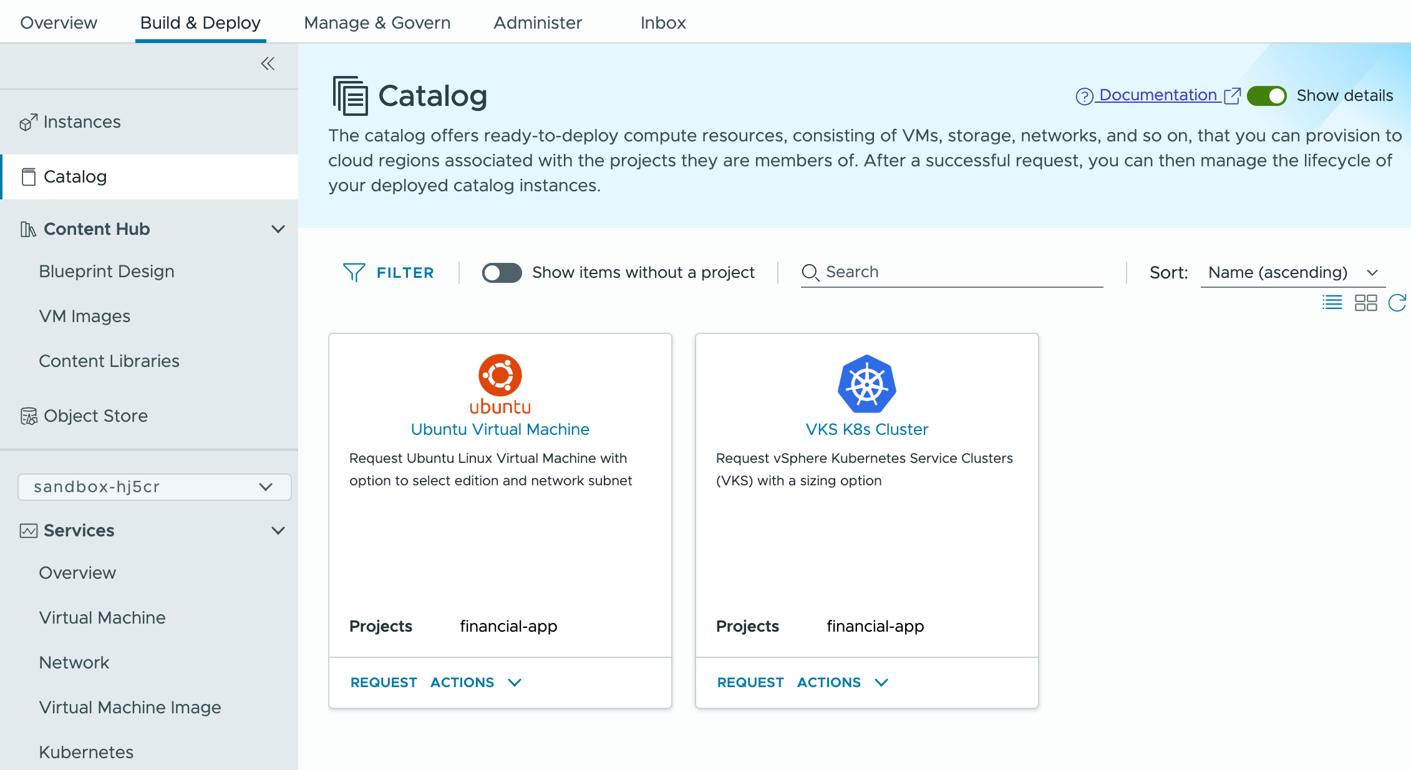
Modern Infrastructure and Multi-tenancy Enables More Use Cases
Example: Infrastructure-as-a-Service (IaaS)
Self-service IaaS for developers, app owners, etc.
Standard deployments with blueprints
Tenant autonomy through role-based access
Central IT governance
Notes:
Key Message:
Modern infrastructure and multi-tenancy facilitate a wider range of use cases. For example, IaaS allows for self-service infrastructure provisioning within a secure, multi-tenant environment, merging speed and consistency with centralized governance and policy control.
Talk Track:
With modern infrastructure and a multi-tenant environment established, more use cases are enabled, such as Infrastructure as a Service (IaaS) and catalog items in VCF Automation, which offers self-service virtual infrastructure provisioning.
It provides a library of standardized IaaS resource policy-driven templates that outline compute, storage, and networking resources, ensuring that each organization can deploy infrastructure within its designated boundaries.
With integrated role-based access control, users can provision resources on demand while IT retains centralized governance, compliance, and oversight.
This streamlines operations, accelerates delivery, and empowers teams to work independently without compromising security or standardization.
Notes:
Resources:

Slide 16
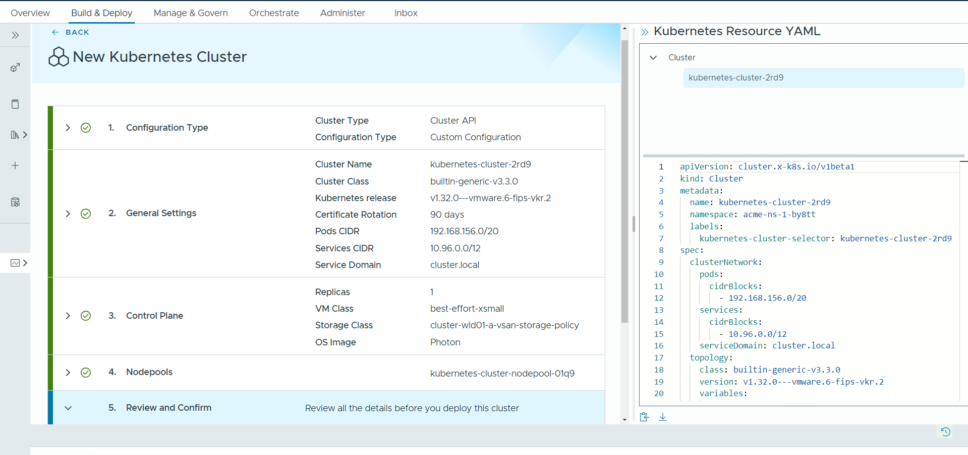
Provide Out-of-the-Box IaaS Services
Self-service cloud experience enabled by Supervisor Services
Simplify the deployment and management of IT resources.
Increase user productivity by reducing dependence on IT Admins.
User-friendly interface to save time and simplify operations.
Comprehensive OOTB IaaS services.
Public cloud-like experience.
Streamline provisioning of IaaS services with VCFA’s interface.
Notes:
Key Message:
With VCFA 9, we provide out-of-the-box Supervisor Services to simplify the deployment of IT resources while increasing user productivity by reducing the dependence on IT Admins with a time-saving user-friendly interface to simplify operations.
Talk Track:
With our comprehensive suite of out-of-the-box services (Core “VM, Kubernetes, Network, Volume” Extended “Data Services, Object Store Services” etc.), we simplify the deployment and management of IT resources.
This allows organizations to quickly scale their infrastructure needs, reduce operational complexities, and focus more on innovation and development rather than on maintaining disparate systems.
OOTB Supervisor services (Supervisor and associated services) are exposed across VCF environments and aggregated into a common endpoint that can be accessed through a choice of interfaces: UI, CLI, or the declarative Kubernetes IaaS API for self-service consumption.
Users can leverage a variety of Supervisor Services such as VM Service that allows you to declaratively define and provision VMs, VKS Service for deploying Kubernetes Clusters, Network Service to deploy Load balancers, Volume Service to deploy Persistent Volumes, Supervisor Services that help you extend the capabilities of the IaaS Platform like, Harbor for OCI Image registry, or Cert Manager for certificate management and the list can go on.
The Self-Service IaaS is an end-user-oriented approach. End users and app teams can freely consume the OOTB Supervisor services just like a public cloud for maximum productivity and efficiency.
End users and app teams can deploy and manage VMs alongside Kubernetes clusters and other vSphere-based resources using a unified management experience.
Notes:
Customer Benefits:
Offer a comprehensive suite of out-of-the-box services (VM, Kubernetes, Network, Volume, Data Services, Object Store Services etc.), which simplifies the deployment and management of IT resources. This allows organizations to quickly scale their infrastructure needs, reduce operational complexities, and focus more on innovation and development rather than on maintaining disparate systems.
Increase end-user satisfaction & productivity – they can get the infrastructure they need when they need it, the way they want it, and w/out having to rely on or wait for other teams.
Leveraging a unified management interface means having a streamlined and user-friendly platform to oversee all Infrastructure as a Service (IaaS) offerings. This can enhance efficiency by reducing the complexity of managing multiple services separately. Customers can expect to easily deploy, monitor, and scale their infrastructure resources from one central location, which saves time and simplifies operations. Additionally, this unified approach can lead to better resource allocation and cost management, ultimately contributing to a more effective use of their IT investments.
Key Attributes:
OOTB Supervisor services (Supervisor and associated services) are exposed across VCF environments and aggregated into a common endpoint that can be accessed through a choice of interfaces: UI, CLI, or the declarative Kubernetes IaaS API for self-service consumption. Users can leverage a variety of Supervisor Services such as VM Service that allows you to declaratively define and provision VMs, VKS Service for deploying Kubernetes Clusters, Network Service to deploy LBs, Volume Service to deploy Persistent Volumes, Supervisor Services that help you extend the capabilities of the IaaS Platform (e.g., Harbor for OCI Image registry, or Cert Manager for certificate management) and the list can go on.
Self-Service IaaS is an end user-oriented approach, which is ideal for dev/test environments, where end users and app teams can freely consume the OOTB Supervisor services just like a public cloud for maximum productivity and efficiency.
End users and app teams deploy and manage VMs alongside Kubernetes clusters and other vSphere-based resources using a unified management experience.
Resources:

Slide 17
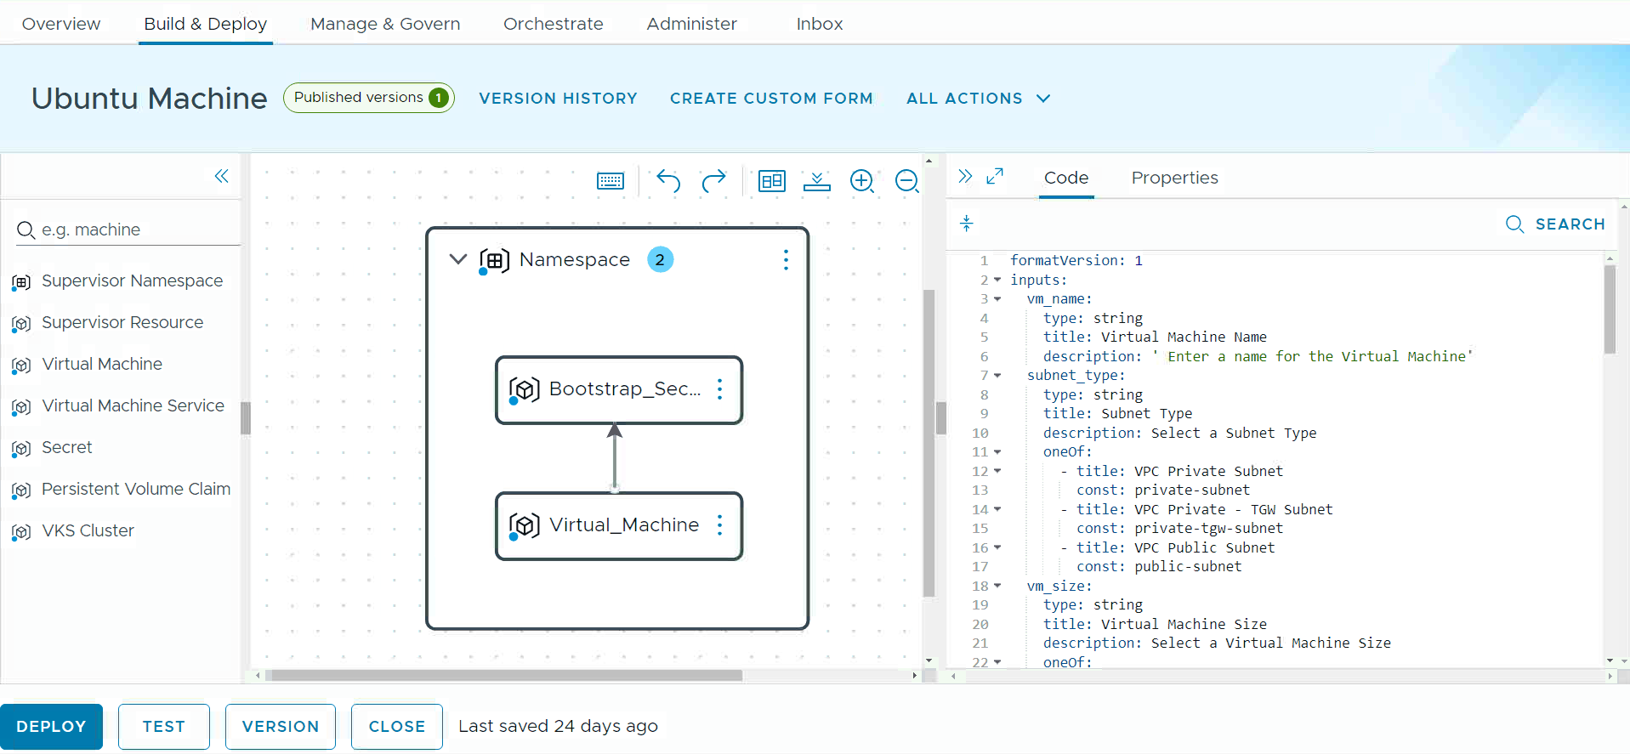
Enforce Infrastructure Governance
Provide custom blueprint development for tailored IaaS services
Implement controls to enhance security and efficiency for reduced downtime.
Accelerate app development and reduce time-to-market.
Self-Service Catalog Experience:
Provide curated catalog items based on IaC templates
Facilitate the creation of customized IaaS services and publish them to the catalog, as needed.
Notes:
Key Message:
With VCFA 9 customers can create custom blueprints tailored to IaaS Services, while enforcing infrastructure governance and enabling self-service consumption.
Talk Track:
One benefit of allowing Enterprise IT Admins to have more control in their environments is enhanced security. With increased control, admins can implement stricter access controls, monitor system activities more closely, and enforce compliance with organizational policies, reducing the risk of unauthorized access or data breaches.
One benefit of providing application teams with more flexibility to consume self-service IaaS resources is the acceleration of development and testing cycles. By allowing teams to quickly provision and configure the necessary infrastructure on-demand, they can focus more on writing and testing code rather than waiting for resources, leading to faster time-to-market for new features and enhancements.
The catalog experience allows users to provision traditional, modern, and generative AI applications. Each catalog item is supported by templates that have been developed and published for the project teams. It is designed for users to utilize the templates provided in the catalog easily.
Create on-demand resources like VMs, Kubernetes, volumes, networks, and storage. This is ideal for users who wish to utilize the design canvas to create resources from scratch and publish them in the catalog.
Notes:
Customer Benefits:
One benefit of allowing Enterprise IT Admins to have more control in production environments is enhanced security. With increased control, admins can implement stricter access controls, monitor system activities more closely, and enforce compliance with organizational policies, thereby reducing the risk of unauthorized access or data breaches; ideal for in-production environments.
One benefit of providing application teams with more flexibility to consume self-service IaaS resources is the acceleration of development and testing cycles. By allowing teams to quickly provision and configure the necessary infrastructure on-demand, they can focus more on writing and testing code rather than waiting for resources, leading to faster time-to-market for new features and enhancements.
Key Attributes:
The catalog experience allows users to provision traditional, modern, and generative AI applications. Each catalog item is supported by templates that have been developed and published for the project teams. It is designed for low-tech users to easily utilize the templates provided in the catalog.
Create on-demand resources like VMs, Kubernetes, volumes, networks, and storage. This is ideal for high-tech users who wish to utilize the design canvas to create resources from scratch and publish them in the catalog.
Resources:

Slide 18
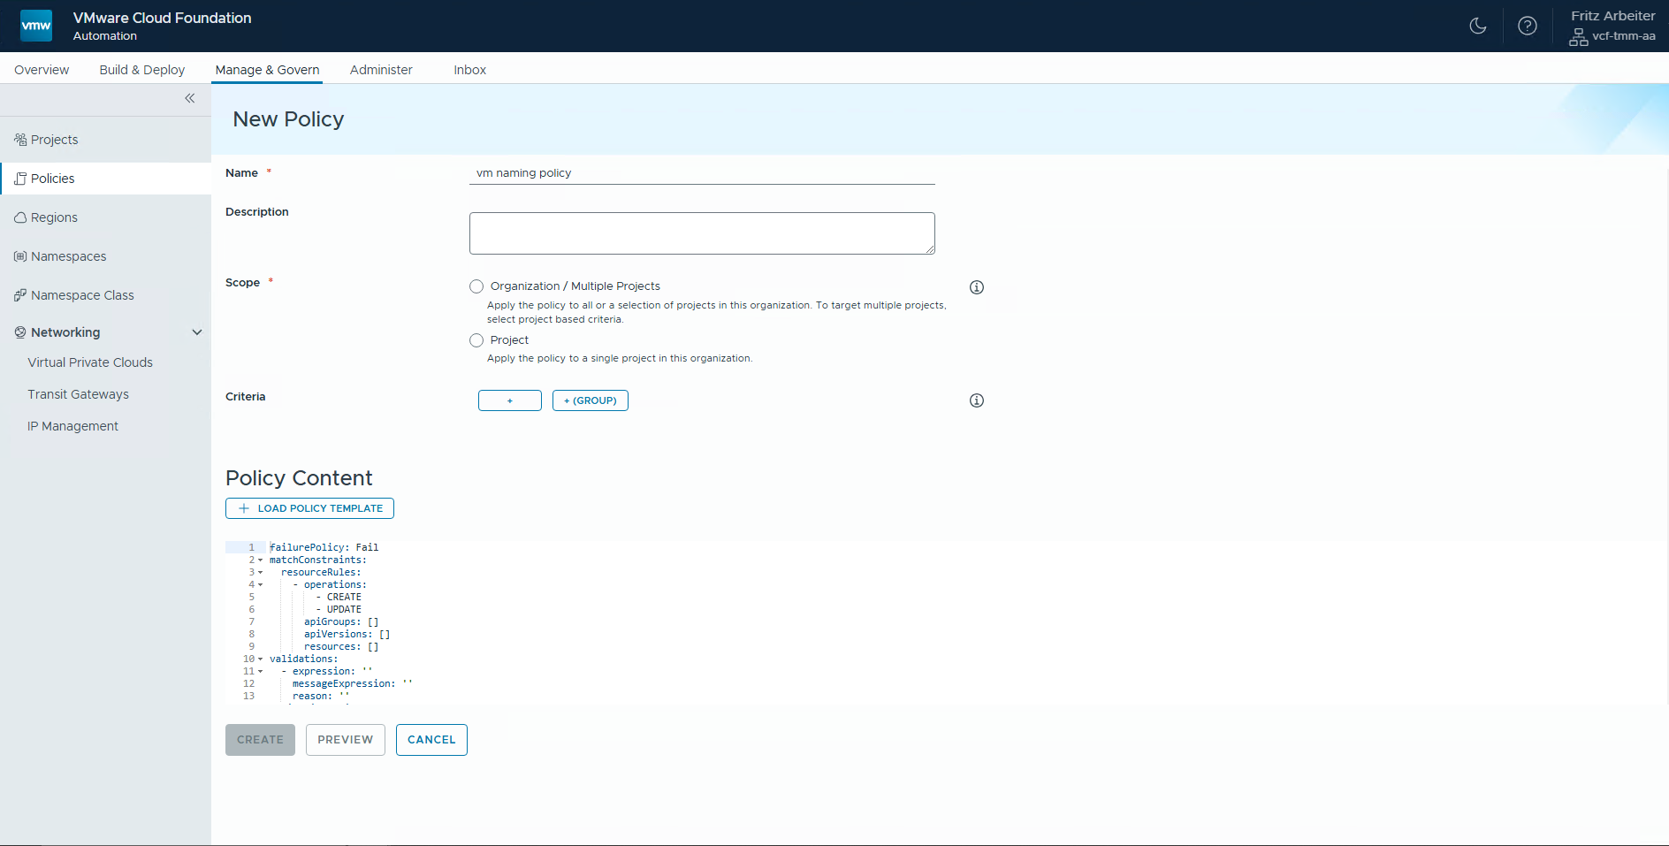
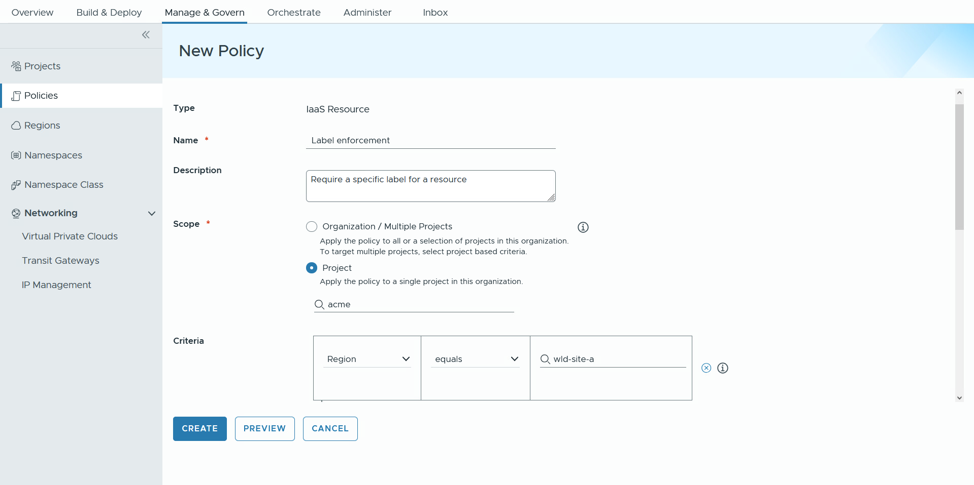
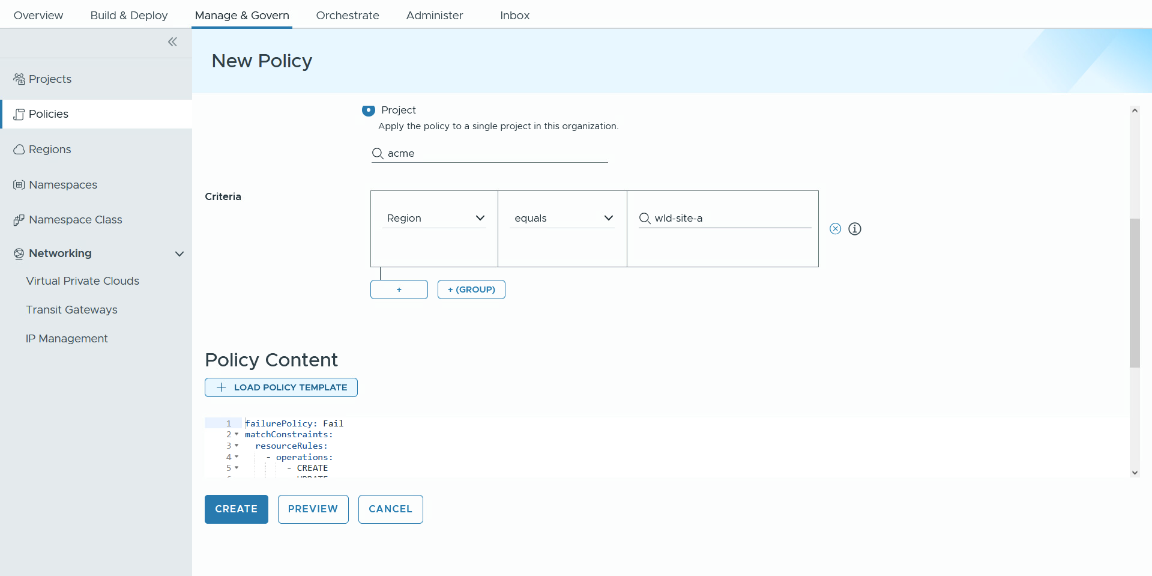
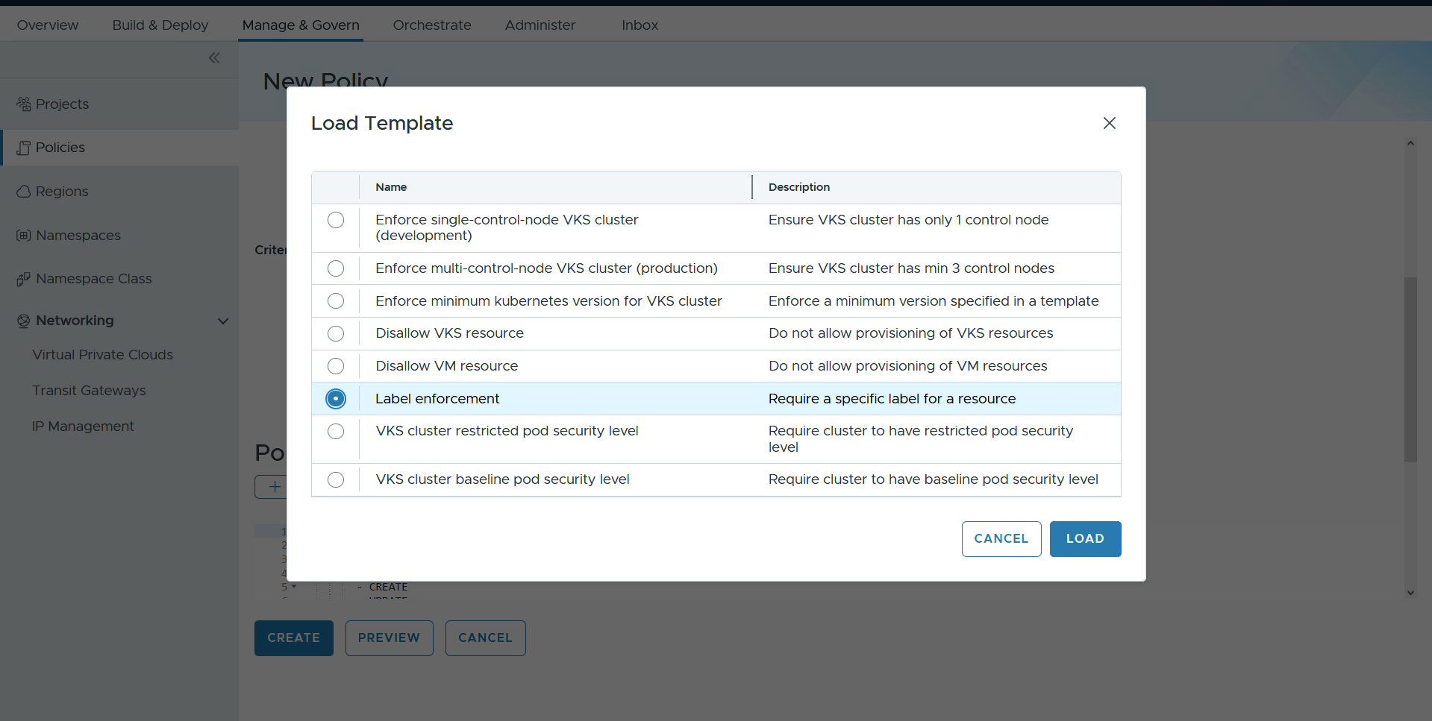
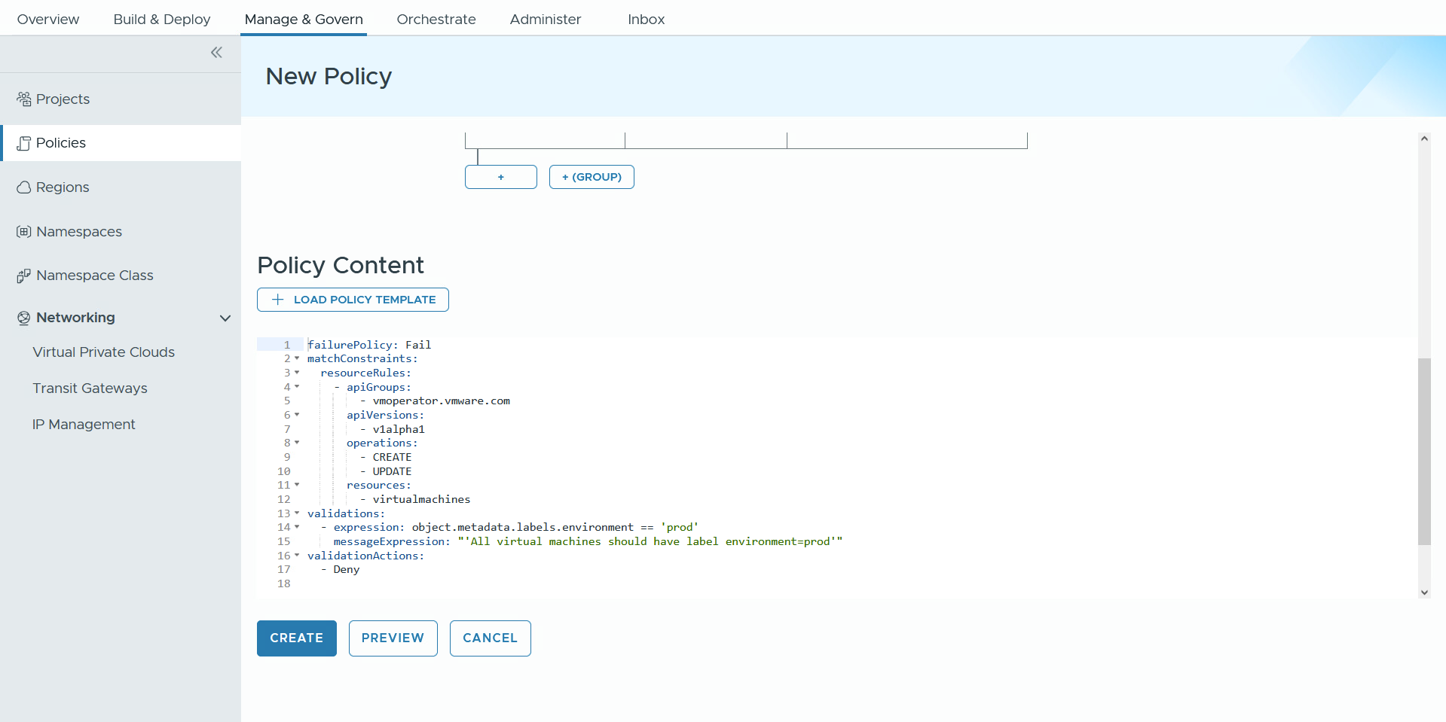
Enforce Best Practices for Resource and Security Configurations
Implement resource policies with Policy as Code.
Create a secure, compliant, and efficient cloud infrastructure while empowering teams with the tools they need to manage policies.
An effective policy management process enables customers to focus on innovation and core business activities.
Flexible framework for implementing IaaS and Kubernetes policies.
OOTB templates for day 0 Kubernetes and VM policies
Notes:
Presenter Note: This slide contains animation.
Key Message:
With VCFA 9 you can implement resource policies with policies-as-code to enforce bast practices for your resources and apply security configurations.
Talk Track:
With VCF Automation 9 you can implement a YAML-based approach to policy as code to enforce best practices for your resources and apply security configurations.
Let’s scroll down to view the policy as code.
<click 1>
and click Load Policy Template.
<click 2>
The pre-defined OOTB templates are designed to streamline the implementation of policies as code for both initial setup (day 0) and ongoing management (day 2) of Kubernetes and VM environments. These templates serve as a solid foundation, allowing users to easily customize and fine-tune their policies through a user-friendly interface or directly via the Kubernetes command-line interface (CLI), ensuring a tailored approach to meet specific operational needs.
With Label enforcement selected click load.
<click 3>
In this example we are enforcing the label prod is applied to all virtual machine resources.
Notes:
Customer Benefits:
Using a YAML-based Policy-as-Code framework with Kyverno for IaaS and Kubernetes offers multiple benefits, including flexibility in adapting policies, automation for consistent enforcement, and improved compliance with security and regulatory standards. It fosters collaboration within the open-source community, enables easy tracking of policy changes through version control, and provides clarity for auditing. Additionally, leveraging an open-source solution helps reduce licensing costs, ultimately enhancing security, compliance, and efficiency in cloud infrastructure.
Customers benefit from pre-defined Out-of-the-Box (OOTB) templates through quick deployment, easy customization, and best practice integration. These templates ensure consistency, reduce complexity, enhance agility, and improve governance, enabling organizations to focus on innovation.
Key Attributes:
Introducing new governance policies that leverage a YAML-based approach to policy as code. To support this initiative, we are using Kyverno, an open-source technology that operates on the backend, enabling us to seamlessly integrate and enforce these policies in a robust and efficient manner.
Resources:

Slide 19
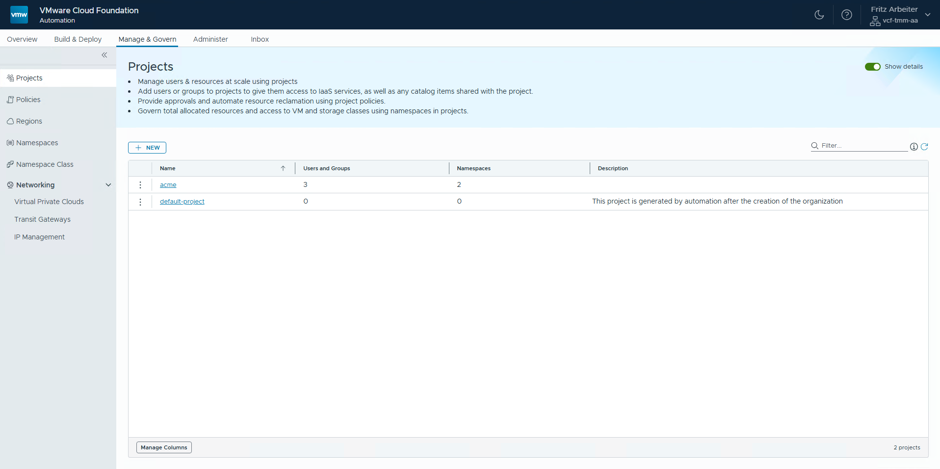
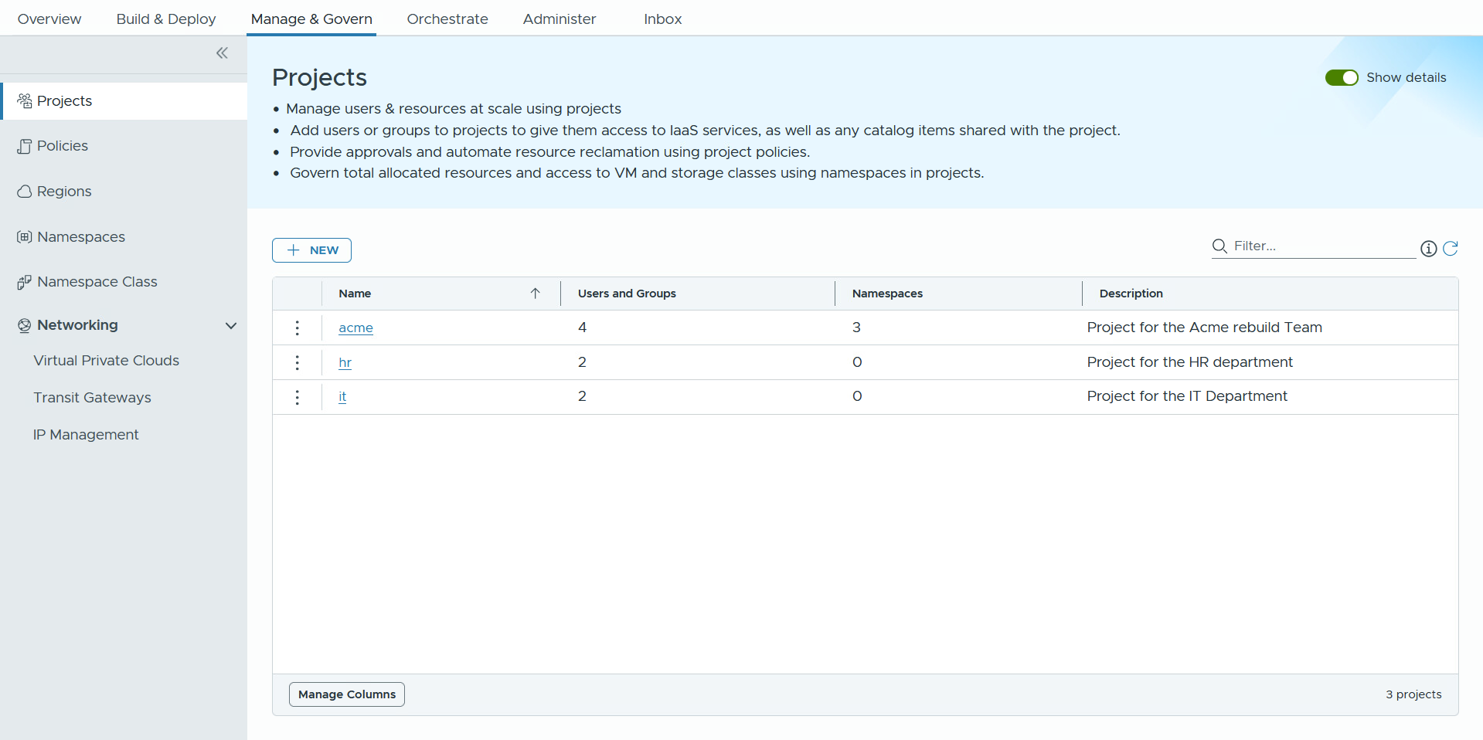
Balancing Access and Efficiency for Optimal Resource Management
Governance for users and resources with Limits and Reservations.
Enhance efficiency and streamline processes of infrastructure resources.
Achieve control over resources, cost, scaling, and overall operational performance.
Organization Admins can create projects and vSphere Namespaces, assign users, and view usage/costs.
A vSphere Namespace is a resource pool that facilitates IaaS provisioning by providing a framework through the vSphere Namespace class.
Notes:
Key Message:
Each org can have specific infrastructure quotas for their region. Orgs enjoy complete network and computing isolation, which means they are entirely separate from one another. This setup makes Org Admins feel like they have their own private cloud, even though the Enterprise IT Admin manages shared VCF vCenter resources in the background. The Org Admin can log into their own portal to create PROJECTS and assign it to different LOBs. In each project, Org Admins can create IaaS NAMESPACES, which define application boundaries, limits on infrastructure use, and reservations so end-users and application teams can easily access modern IaaS services. Each vSphere Namespace can be under an isolated networking domain (VPC).
Talk Track:
With governance for users and resources, IT Admins can enable effective resource management through capabilities like reservations and limits, ensuring that critical applications receive the necessary resources while avoiding over-provisioning, which leads to cost savings.
Organization Admins can create and manage multiple projects while assigning specific users to each project (LOBs).
After the creation of a project, vSphere Namespaces can be created.
Org Admins can create and configure namespaces, with namespace classes, to set quotas, reservations, content libraries, and Virtual Private Clouds (VPC).
The vSphere Namespace is an advanced resource pool that provides features such as utilization, reservations, limits, and the ability to provision various IaaS Services.
The Namespace class is a template that can be tailored based on the specific needs of the namespace, whether they are small, medium, or large. It enforces limits on resource consumption to prevent individual users from monopolizing resources, especially in multi-tenant environments.
Org Admins can also gain insights into utilization at the organizational, project, vSphere Namespace, and infrastructure level (VM and VKS clusters).
Also, Org admins can view costs at the organizational level, region quota, and namespace levels.
Notes:
Customer Benefits:
Establishing a well-defined distribution of infrastructure resources, including quotas and policies, for each application team is essential. This approach not only fosters accountability and clarity among teams but also ensures that resources are utilized effectively, promoting collaboration and reducing potential conflicts over resource allocation. By doing so, Org Admins can enhance overall productivity and allow each app team to focus on their specific goals with the necessary support.
Enable effective resource management through capabilities like reservations and limits, ensuring that critical applications receive the necessary resources while avoiding over-provisioning, which leads to cost savings. The flexibility to customize namespace classes allows for efficient scaling to meet changing business demands.
Key Attributes:
Org Admins can create and manage multiple projects while assigning specific users to each project (LOBs). Org Admins can also gain insights into utilization and costs at the organizational, project, and vSphere Namespace levels. During the creation of a project, vSphere Namespaces can be dynamically created and attached. Org Admins can customize namespaces by setting quotas, reservations, content policies, and Virtual Private Clouds (VPC).
The vSphere Namespace is an advanced resource pool that provides features such as utilization, reservations, limits, and the ability to provision various IaaS Services. The Namespace class is a template that can be tailored based on the specific needs of the namespace, whether they are small, medium, or large. It enforces limits on resource consumption to prevent individual users from monopolizing resources, especially in multi-tenant environments. The built-in reservations ensure guaranteed resource availability for critical applications, while quotas help control resource usage and spending, aligning with organizational policies.
Resources:

Slide 20
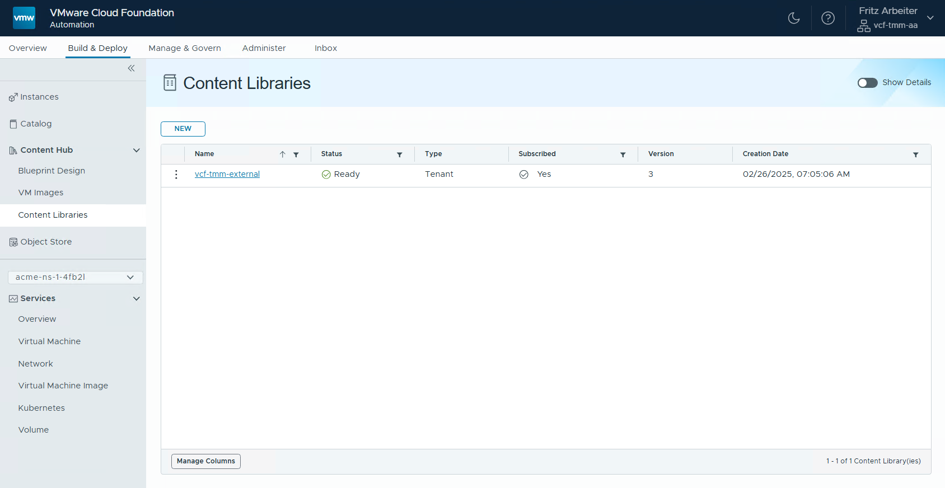
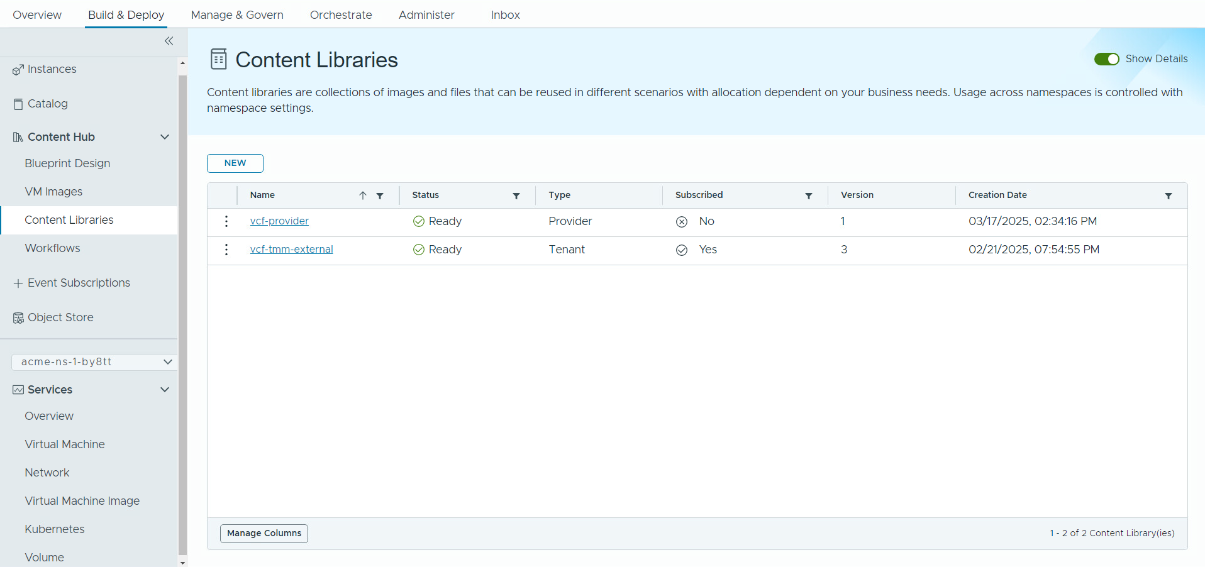
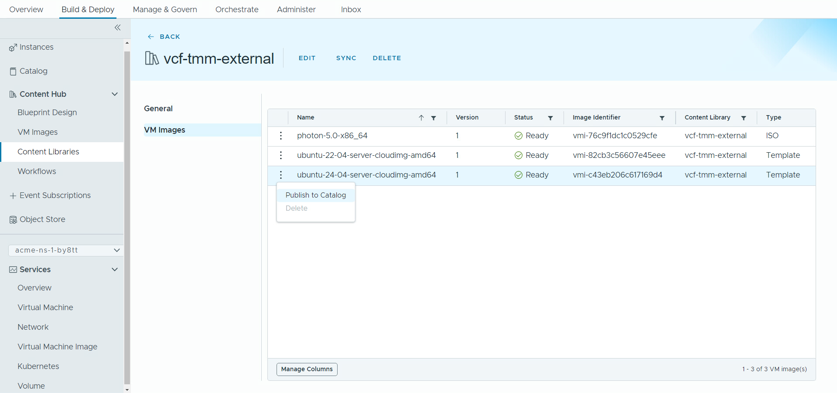
Simplify the Content Management Experience
Centralize content management via Content Hub
Streamline the overall content management process.
Boost productivity and collaboration with a unified content portal.
Discover vCenter content libraries automatically and allocate new or existing libraries to one or more organizations.
Publish content to the self-service catalog with one click.
Create orchestrator workflows in VCF Automation that can be easily published to the catalog.
Notes:
Key Message:
With centralized content management via the content hub, customers can streamline the overall content management process while improving productivity and collaboration with a unified content management portal.
Talk Track:
Centralized content management enables IT Admins to easily discover, create, and allocate content libraries directly within VCF Automation, reducing complexity, minimizing errors, and streamlining the overall management process. This leads to increased efficiency and better resource allocation for customers.
By consolidating the IT Admin published content and the Organization Admin created/imported content in one place, VCF Automation simplifies sharing resources across various projects. This enhances collaboration among team members and ensures that everyone has quick access to the necessary tools and assets, which ultimately improves project execution and boosts overall productivity.
The ability for Org Admins to publish content to the self-service catalog streamlines access to resources by allowing quick publication with a single click. This enables end-users and app teams to independently consume resources without waiting for approvals. This empowerment fosters innovation and boosts productivity while allowing Org Admins to efficiently manage and update content, ensuring end users/app teams can access the latest information.
Improved user experience by integrating the Orchestrator UI into the VCF Automation UI under the Orchestrate tab, making it easier to navigate and reducing the need for a separate interface. This streamlines workflow creation and management in a consistent environment.
The Content Hub Management was designed specifically for Org Admins and Line of Business (LOB) teams to efficiently manage a wide array of resources. This includes content libraries, virtual machine (VM) images, blueprints, and orchestrator workflows. Users can seamlessly organize and maintain these resources in one location, simplifying the process of sharing them across multiple projects.
<click 1>
Org Admins can publish content to the self-service catalog with a single, easy click. This streamlined process allows them to make resources readily available to end-users and app teams, empowering them to access and utilize the content efficiently.
<click 2>
Users can build orchestrator workflows directly from VCF Automation. These workflows can be published into a catalog.
Notes: Customer Benefits:
Centralized content management enables IT Admins to easily discover, create, and allocate content libraries directly within VCFA, reducing complexity, minimizing errors, and streamlining the overall management process. This leads to increased efficiency and better resource allocation for customers.
By consolidating the IT Admin published content and the Org Admin created/imported content in one place, VCFA simplifies the process of sharing the resources across various projects. This enhances collaboration among team members and ensures that everyone has quick access to the necessary tools and assets, which ultimately improves project execution and boosts overall productivity.
The ability for Org Admins to publish content to the self-service catalog streamlines access to resources by allowing quick publication with a single click. This enables end-users and app teams to independently consume resources without waiting for approvals. This empowerment fosters innovation and boosts productivity while allowing Org Admins to efficiently manage and update content, ensuring end users/app teams have access to the latest information.
Improved user experience by integrating the Orchestrator UI into the VCFA UI under the Orchestrate tab, making it easier to navigate and reducing the need for a separate interface. This streamlines workflow creation and management in a consistent environment.
Key Attributes:
All existing customers utilize the vCenter content library for VM image management. Before the introduction of VCF 9.0, managing the content library across multiple vCenters and data centers involved a “publish and subscribe” model. In this model, one vCenter acted as the publisher, hosting the content library, while the other vCenters served as subscribers. This setup, known as "pub and sub," could become quite complicated, especially with many vCenters across multiple data centers, leading to significant challenges in synchronizing content libraries. With VCF 9.0, we are consolidating content library management within VCFA. In VCFA, we connect to all vCenters to discover all content libraries. This process allows the IT Admin to allocate a content library to one or all organizations. VCFA automatically synchronizes these libraries with the vCenters in the background, streamlining the process. In VCF 9.0, you can also create a new content library directly within VCFA, add one or more VM images to this library, and allocate it to one or more organizations, as needed. All of these tasks can be accomplished within VCFA without relying on the previous "pub and sub" model, simplifying management and eliminating associated complexities. Another important feature to note is that users can leverage the same content library across multiple vCenters via Regions; it’s a cool feature that a lot of customers identified as missing from the vCenter content library that VCFA currently provides.
The Content Hub Management was designed specifically for Org Admins and Line of Business (LOB) teams to efficiently manage a wide array of resources. This includes content libraries, virtual machine (VM) images, blueprints, and orchestrator workflows. Users can seamlessly organize and maintain these resources in one location, simplifying the process of sharing them across multiple projects.
<click 1>
Org Admins can publish content to the self-service catalog with a single, easy click. This streamlined process allows them to make resources readily available to end-users and app teams, empowering them to access and utilize the content efficiently.
<click 2>
Org Admins and Lines of Business (LOBs) no longer need a separate product to access workflow orchestration. This capability is now available as a feature within VCFA called "orchestrate." Users can build orchestrator workflows directly from VCFA. These workflows can be published into a catalog or triggered based on various events generated within VCFA, utilizing what we refer to as the "event broker system." With the extensibility feature, users can view a list of all system events generated and subscribe to them. For different events, they can trigger distinct workflows. For instance, if an event is generated after a VM is successfully created, they can subscribe to it and initiate an orchestrator workflow that registers the VM in a CMDB within their environment.
Resources:

Slide 21
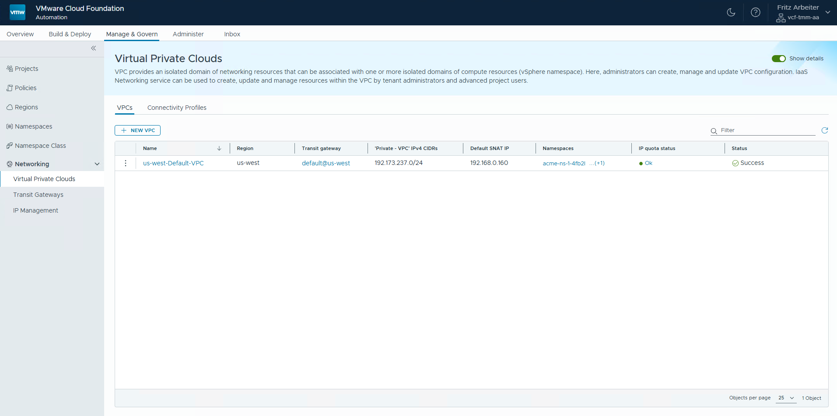
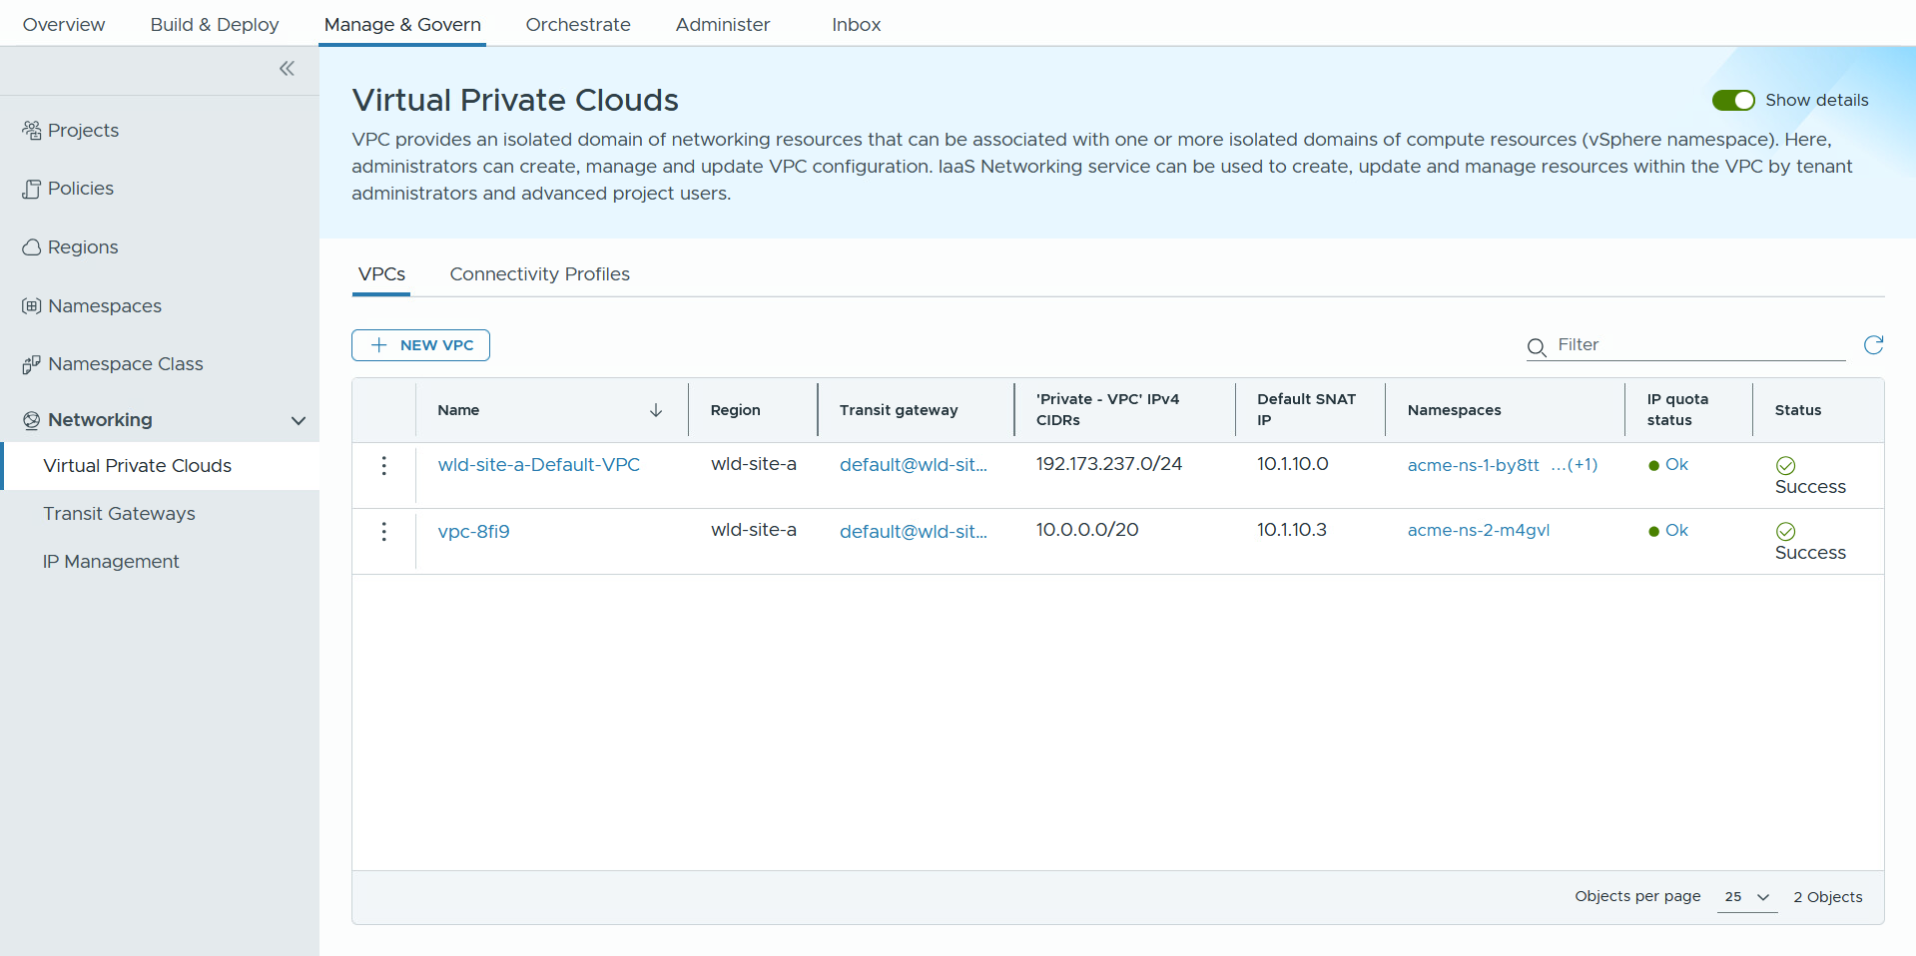
Support Network Governance and Enable Self-service Networking
Manage IP Addresses and Isolation via VPCs.
Enhance Security through network isolation.
Leverage VPCs networks for each application team to ensure isolation.
Link each VPC to one or more vSphere Namespaces for resource control.
Oversee IP addresses provided by IT Admins or external Providers to prevent conflicts.
Develop and manage IP addresses for internal use.
Notes:
Key Message:
Complete network governance for Org Admin with the power to enable self-service networking for consumers.
Talk Track:
By creating network isolation domains (VPC) for different application teams, organizations can significantly improve their security posture. Each team’s resources are separated, which minimizes the risk of data breaches and unauthorized access.
Managing IP addresses locally and coordinating them effectively with IT Admins or Providers allows for better resource allocation and reduces conflicts. This ensures that applications run smoothly without network disruptions.
Set up dedicated network isolation domains (VPCs) tailored for different application teams within the organization. This ensures that each team operates within its secure environment, minimizing the risk of cross-team interference and enhancing network security.
Allocate the created virtual private clouds (VPCs) to one or more vSphere Namespaces. This integration allows for better resource management, ensuring that each namespace can leverage the benefits of its assigned VPC for enhanced isolation and control over network resources.
Oversee the distribution and management of IP addresses provided by IT Administrators. This includes tracking allocated addresses, ensuring proper subnetting, and maintaining an organized IP address inventory to prevent conflicts and streamline network operations.
Develop and oversee a range of IP addresses that are specifically designated for use within the organization. This involves planning IP address allocations, managing the lifecycle of these addresses, and ensuring compliance with organizational policies and standards for internal network management.
Notes: Customer Benefits:
By creating network isolation domains (VPC) for different application teams, organizations can significantly improve their security posture. Each team’s resources are separated, which minimizes the risk of data breaches and unauthorized access. Customers care about this because protecting sensitive information and maintaining compliance with regulations are critical for their business integrity and trustworthiness.
Managing IP addresses locally and coordinating them effectively with IT Admins or Providers allows for better resource allocation and reduces conflicts. This ensures that applications run smoothly without network disruptions. Customers value this benefit as it leads to improved operational efficiency and reduced downtime, ultimately enhancing their productivity and cost-effectiveness in managing their IT infrastructure.
Key Attributes:
Set up dedicated network isolation domains (VPCs) tailored for different application teams within the organization. This ensures that each team operates within its secure environment, minimizing the risk of cross-team interference and enhancing network security.
Allocate the created virtual private clouds (VPCs) to one or more vSphere Namespaces. This integration allows for better resource management, ensuring that each namespace can leverage the benefits of its assigned VPC for enhanced isolation and control over network resources.
Oversee the distribution and management of IP addresses provided by IT Administrators or external Providers. This includes tracking allocated addresses, ensuring proper subnetting, and maintaining an organized IP address inventory to prevent conflicts and streamline network operations.
Develop and oversee a range of IP addresses that are specifically designated for use within the organization. This involves planning IP address allocations, managing the lifecycle of these addresses, and ensuring compliance with organizational policies and standards for internal network management.
Resources:

Slide 22
Add-on Services

Slide 23
Delivering the Modern Private Cloud
VCF Advanced Services
Private AI
DR and Ransomware Recovery
Advanced
Security
Load Balancing
Application Services
Data Services
Network
Observability
Business Operations
Secure Access
VMware Cloud Foundation 9.0
Modern Cloud Interface
Tenant Management, Content
Service Catalog, Orchestration, Apps
AI / ML
Traditional VMs
K8s
CONSUMER
Automation and Operations
Capacity, Configuration, Tenancy
SRE Ops, Fleet and Security Management,
CLOUD ADMIN
Compute (VMware vSphere)
Storage (VMware vSAN)
Networking (VMware NSX)
On Prem
Public Cloud
Sovereign Cloud
Edge
Telco
The information in this presentation is for informational purposes only and may not be incorporated
into any contract. There is no commitment or obligation to deliver any items presented herein.
Notes:
Key Message: Introduce VMware Advanced Services (Add-on Licenses) Talk Track:
VCF as a private cloud platform can also be deployed with a portfolio of advanced capabilities that help customers support an extended set of use use cases to further drive innovation and improve operational resilience.
These advanced services are available as add-on licenses and include capabilities such as Private AI which I touched on earlier where customers can securely deploy and scale AI workloads within their private cloud. Other advanced services are also available, in fact there are several.
We have DR and Ransomware Recovery, delivering built-in protection and rapid recovery from cyber threats.
There are is also Advanced Security which strengthens lateral security and zero-trust architectures,
And then there is Load Balancing and Application Services which ensure better performance and availability for modern applications.
We also see customers leveraging Data Services to optimize storage for AI, databases, and container workloads
And we have Network Observability to gain deeper visibility into traffic patterns and performance across the environment.
Finally, capabilities like Business Operations automation and Secure Access help customers drive efficiency, enforce governance, and improve user access control across the private cloud.
Consumers can access these services through their preferred language, whether it's APIs, CLIs, or infrastructure-as-code, providing a flexible and scalable platform that meets a variety of needs.
Notes:
VCF Advanced Services require an add-on license. Resources:

Slide 24

A Robust Catalog of
Advanced Services
Private AI
Secure Access
VMware Private AI Foundation with NVIDIA
Identity Access Management
Privileged Access Management
DR and Ransomware Recovery
Business Operations
Automic Automation by Broadcom
ValueOps by Broadcom
VMware Live Recovery
Advanced Security
Network Observability
VMware vDefend Firewall
VMware vDefend Firewall w/ATP
Network Observability by Broadcom
Load Balancing
Data Services
VMware Avi
Load Balancer
VMware Data Services Manager
VMware Tanzu Data Suite
Application Services
VMware Data Services
VMware Tanzu Rabbit MQ
/
VMware Tanzu Platform
VMware Tanzu Spring Essentials
VMware Tanzu App Catalog
Notes:
Key Message:
VMware Cloud Foundation offers a comprehensive suite of Advanced Services designed to extend the core capabilities of the platform and address diverse business needs.
Each service is engineered to integrate seamlessly with VCF, providing organizations with the flexibility to tailor their private cloud environments to specific requirements.
By leveraging these Advanced Services, customers can enhance security, accelerate innovation, and achieve greater operational efficiency within their private cloud infrastructure.
Talk Track:
VMware Cloud Foundation is much more than just infrastructure — it’s also a platform for advanced capabilities that help customers support new use cases, drive innovation, and improve operational resilience.
These advanced services include areas like Private AI, where customers can securely deploy and scale AI workloads within their private cloud, and DR and Ransomware Recovery, delivering built-in protection and rapid recovery from cyber threats.
Advanced Security strengthens lateral security and zero-trust architectures, while Load Balancing and Application Services ensure better performance and availability for modern applications.
We also see customers leveraging Data Services to optimize storage for AI, databases, and container workloads, and Network Observability to gain deeper visibility into traffic patterns and performance across the environment.
Finally, capabilities like Business Operations automation and Secure Access help customers drive efficiency, enforce governance, and improve user access control across the private cloud.
In the next few slides, we’ll walk through each of these categories at a high level so you can see how VCF Advanced Services open up even more value for customers beyond just the core deployment. Notes: VCF Advanced Services require an add-on license. Resources:

Slide 25
Resources
Notes:
Key Message:
This section details some additional resources that you may find helpful.
Talk Track:
This section details some additional resources that you may find helpful.
Notes:
Resources:

Slide 26
Get hands-on experience with VMware Cloud Foundation
VMware Cloud Accelerator Hands-On Platforms
Hands-on Labs
Experience real VMware products, no setup needed
Guided and self-paced learning—follow manuals or explore freely
Evaluate, learn, and test VMware solutions
*Performance and scale are limited
VCF Experience Day
8-10 hours of lecture and hands-on exercises
Facilitated by a local VCF SME
Lab capacity booked in advance
Holodeck Toolkit
Long-running nested sandbox on a physical vSphere host
Deployable to the customer datacenter
Augment the need for POC
Available in standalone and scalable partner design
Hands-on for multiple teams within a datacenter
Notes:
Key Message:
We offer a range of resources designed to meet you where you are in your learning journey, from quick explorations to in-depth, dedicated experiences.
Talk Track:
Hands-on Labs:
First, VMware Hands-on Labs serve as your gateway to experiencing our products without any infrastructure setup. Think of it as instant access to a fully functional VMware environment from your browser. Whether you prefer a structured approach with step-by-step manuals or want to explore features at your own pace, Hands-on Labs accommodates both. It's perfect for evaluating solutions, building your skills, and even running proof-of-concepts.
VCF Experience Day:
We offer VCF Experience Days for a more immersive experience focused on VMware Cloud Foundation. These events are more intensive, typically involving 8 to 10 hours of combined lecture and hands-on exercises. A key benefit is the guidance of a local VCF Subject Matter Expert, who can provide valuable insights and answer your specific questions. These events are scheduled, and lab capacity is booked to ensure a high-quality experience.
Holodeck Toolkit:
We offer the VMware Holodeck Toolkit for those needing a persistent, long-term environment. This toolkit allows you to deploy a nested sandbox on a physical vSphere host, even within your data center. The Holodeck is designed to augment or even replace the need for traditional POCs, providing a more cost-effective and flexible solution. It's available in standalone and scalable partner designs, and importantly, it supports hands-on access for multiple teams within a data center, facilitating collaborative learning and evaluation. Notes: Resources:

Slide 27

VMware Cloud Foundation Resources
Product Page
https://www.vmware.com/products/cloud-infrastructure/vmware-cloud-foundation
Documentation
https://techdocs.broadcom.com/us/en/vmware-cis/vcf.html
Blogs
https://blogs.vmware.com/cloud-foundation/
VMware
Feature Request
Portal
Hands-On Labs
https://www.vmware.com/resources/hands-on-labs
https://vcf.ideas.aha.io/
Holodeck
https://www.vmware.com/resources/resource-center?category[]=Hands-on%20Labs
Community
https://community.broadcom.com/vmware-cloud-foundation/home
FAQ
https://www.vmware.com/docs/vmw-cloud-foundation-faqs
YouTube
https://www.youtube.com/c/VMwareCloudFoundation
VCF Posters
https://www.vmware.com/info/vmware-cloud-foundation/resources#infographics
Notes:
Key Message:
Valuable VMware Cloud Foundation Resources.
Talk Track:
Here is a list of useful additional VMware Cloud Foundation resources. Notes: Resources:

Slide 28
VMware Cloud Foundation Training Path
Basic
Level 200
Level 300
Intermediate
Advanced
Level 100
VCF Overview
Get started with documentation and videos to learn about VCF.
VCF Data Sheet
This datasheet describes VCF and its key use cases.
TCO White Paper
Learn how to save with VCF in this total cost of ownership whitepaper.
Total Economic Impact Study
Forester's study on the total economic impact of VCF.
Hands-on Labs (HOLs)
Self-paced online environments with guided exercises.
VMware Resource Center
Technical papers, demos, and more.
Cloud Foundation YouTube Channel
Demos, how-to guides, and more.
Cloud Foundation Webinars
Register for webinars and watch replays.
Frequently Asked Questions
VCF Experience Day
Unlock the power of VMware Cloud Foundation with our exclusive, expert-led hands-on workshops. These invite-only events offer a deep dive experience to understand VCF comprehensively.
VCF Holodeck
Experience VCF using a nested deployment on a single vSphere host. Holodeck automates the deployment and configuration of VCF for hands-on experience using self-paced lab modules.
Notes:
Key Message:
A learning path to help you gain expertise in VMware Cloud Foundation, progressing from foundational knowledge to advanced hands-on experience.
Talk Track:
Level 100 Basic Information:
We focus on building a solid understanding of VCF. Start with our documentation and introductory videos to familiarize yourself with the core concepts. The VCF Datasheet provides a concise overview of VCF and its key use cases, offering a clear picture of its capabilities. To understand the economic benefits, the TCO White Paper outlines how VCF can lead to significant cost savings compared to traditional infrastructure. Finally, Forrester's Total Economic Impact Study presents a real-world perspective, demonstrating the tangible business value and ROI that VCF delivers to organizations.
Level 200 Intermediate Skills:
We are transitioning to more interactive and practical learning. VMware Hands-on Labs (HOLs) are crucial in this regard. These self-paced, online environments provide guided exercises that enable you to directly experience VCF features and functionalities. The VMware Resource Center is your go-to source for in-depth technical content, including papers, demos, and best practices. The Cloud Foundation YouTube Channel offers demos, how-to guides, and other video resources for visual learners. Stay updated with the latest developments and insights by joining our Cloud Foundation Webinars and accessing valuable information through our Frequently Asked Questions.
Level 300 Advanced Expertise:
You'll engage in our most immersive and hands-on programs. VCF Experience Day provides exclusive, expert-led workshops that offer a deep dive into VCF. These invite-only events give you a comprehensive understanding of VCF through intensive hands-on exercises and direct interaction with experts. For a dedicated, in-environment experience, the VCF Holodeck allows you to deploy a nested VCF environment on a single vSphere host. This automated deployment and self-paced lab modules provide extensive hands-on practice. Notes: Resources:

Slide 30
Converged Software Bill of Materials
Unified VMware Cloud Foundation release version
VMware SDDC Components of the Private Cloud
vSphere 9
ESX | vCenter Server | vSAN | VKS
NSX 9
VMware Cloud Foundation 9
VCF Operations 9
VCF-Ops | VCF Ops for Logs | VCF Ops for Networks | HCX
SDDC Manager 9
VCF-Automation 9
Notes:
Presenter note – this slide contains animation.
Key Message
VCF 9 introduces a converged software bill of materials.
VCF integrates compute, storage, networking, automation and operations into a single platform and provides all the components for a fully functional private cloud.
Talk Track:
VMware Cloud Foundation is built on trusted VMware technologies for the modern private cloud which include compute, storage, networking, operations and automation. These technologies are the building blocks of a full software-defined data center which are integrated into a single platform that is easy to consume.
VCF 9 introduces a converged software bill of materials.
<click>
From VCF 9, VMware Cloud Foundation uses a common release version number. All VCF components will follow the same release version number as the VCF product.
Extended Talk Track (optional): (This describes the VCF components and the value that each delivers).
VMware vSphere is the most trusted hypervisor in the industry. The vSphere Kubernetes Service (VKS) transforms vSphere to a platform for running Kubernetes workloads natively on the hypervisor layer together with virtual machines within dedicated resource pools. - For storage, Cloud Foundation uses VMware vSAN. Next generation vSAN Express Storage Architecture (ESA) delivers high-performance, highly scalable storage embedded in the hypervisor that allows you to deliver hyperconverged infrastructure (HCI) or disaggregated storage clusters and provides data services such as deduplication and compression, data protection and replication and in-built storage policy-based management. VSAN eliminates the need for external shared storage and simplifies storage configuration and provisioning of virtual machines and containerized workloads.
- VMware NSX is the network virtualization platform that enables the virtual cloud network, a software-defined approach to networking that extends across data centers, clouds, and application frameworks. Just as vSphere has changed the operational model for VMs, NSX allows networks to be provisioned and managed independent of underlying hardware.
NSX reproduces the entire network model in software, enabling any network topology—from simple to complex multi-tier networks—to be created and provisioned in seconds. Data canter operators can now achieve levels of agility, security and economics that were previously unattainable when manually maintaining physical network and security components.
- From VCF 9, private cloud operations and management is performed using the VCF Operations Console. VCF Operations (formerly VMware Aria Operations) enables IT to deliver a private cloud with a unified and feature rich operations experience which spans compute, storage, networking, fleet management and lifecycle management. VCF Operations provides visibility, optimization, efficient capacity planning, app-aware remediation, integrated compliance and full stack lifecycle management. Customers benefit from consistency, improved application performance and infrastructure optimized for cost, capacity, and governance.
- VCF Automation (formerly VMware Aria Automation) delivers a self-service private cloud with governance and resource lifecycle management across on-premises private cloud infrastructure. It leverages a service-driven cloud computing interface, a policy controlled self-service catalog, Infrastructure as Code (IaC), and infrastructure pipelining. VCF Automation enables Cloud Ops teams to maintain frictionless governance and control while empowering developers with a high level of agility and flexibility.
Notes:
SDDC Manager 9 is installed or upgraded as a component of any VCF 9 instance. From VCF 9 VCF Operations is used for management. The SDDC Manager UI will be deprecated in a future release.
VCF 9 supports both vSAN original storage architecture (OSA) and vSAN express storage infrastructure (ESA).
The VKS service allows IT operators and developers to provision fully configured Kubernetes clusters quickly and efficiently, ensuring that these clusters are automatically integrated with the underlying VCF infrastructure for networking, storage, and security.
- VCF Automation becomes the single interface for cloud consumption and combines the capabilities of VMware Aria Automation and VMware Cloud Director.
References:
For further information on the Cloud Foundation Bill of materials and new features please refer to the Cloud Foundation Release Notes.
https://docs.vmware.com/en/VMware-Cloud-Foundation/index.html

Slide 31

VCF Edge
Cost-effective licensing for VCF deployments which span multiple locations
V\
Centrally Managed Remote Edge
Remotely Managed
Standalone Edge
Air-Gapped
Edge
Centrally Managed
Far Edge Deployment
Internet/WAN
Admin
Internet/WAN
Internet/WAN
Internet/WAN
Management Control Plane
Management Control Plane
Management Control Plane
Management Control Plane
Admin
Admin
Admin
VCF Edge
VCF Main DC
VCF Main DC
VCF Edge
VCF Edge
VCF Edge
Edge Sites
Notes:
Presenter Note: This slide contains animation
Key Message:
VCF Edge licensing caters to multiple deployment options to meet the needs of any business. VCF Edge licensing is not to be confused with VCF remote site architecture.
Talk Track:
VMware Cloud Foundation Edge is a flexible licensing mechanism which can be used to support a variety of different use cases. The end-result is a highly secure private cloud platform which is cost effective and can span multiple edge locations. Here is an overview of the deployment options available for VCF Edge.
Customers can deploy VCF Edge as a remote workload domain or cluster at an edge location while still maintaining the control plane at a central DC. This can be done both with the SDDC Manager or manually without the SDDC Manager.
<click>
Standalone Edge, allows customers to deploy the full VCF SDDC stack at the edge, with the control plane located at the Edge site. This is great for customers with sites that have intermittent WAN or Internet access. Each Standalone Edge could be a separate VCF instance. For smaller environments this could be a separate consolidated VCF instance.
<click>
Air Gapped or Dark Site Edge allows customers with offline site requirements to deploy all the capabilities and features of VCF without the need for internet or WAN access.
<click>
Far Edge, can be deployed manually using VVF architectures, at the edge while connecting to a centrally managed vCenter Server.
In each of these scenarios VCF Edge licensing includes entitlements to all VCF components.
Notes:
In each of these scenarios VCF Edge licensing includes entitlements to all VCF components.
VCF Edge licensing SKU requires :
Min of 10 or more sites
min 8 cores per CPU
256 cores max per site
Deployments of VCF 5.0 and above
Far Edge refers to deployments which may not satisfy the minimum bandwidth and latency connectivity requirements required for NSX when configuring a VCF workload domain or cluster.
Each Edge deployment option (with the exception of Far Edge) must meet the connectivity requirements: - 10MBps min connectivity between sites - Less than 100ms latency between sites. - Two (2) connections between each site is also recommended.
Resources:

